Slide 1

People care about resource distribution
Notes on Behavioural Economics
Jason Collins

Slide 2

https://www.sacbee.com/news/databases/state-pay/

Slide 3
Distributional preferences

Slide 4

Distributional preferences
$$U_{i}\left(x_{i} \right)=x_{i}$$
$$U_{i}\left(x_{i},x_{j}\right)=x_{i}+αx_{j}$$

Slide 5
Distributional preferences
Deviation from self-interest
Inequality and social comparison
Workplace and policy design

Slide 6
Distributional preferences
Altruism
Inequality aversion
Other social preferences

Slide 7
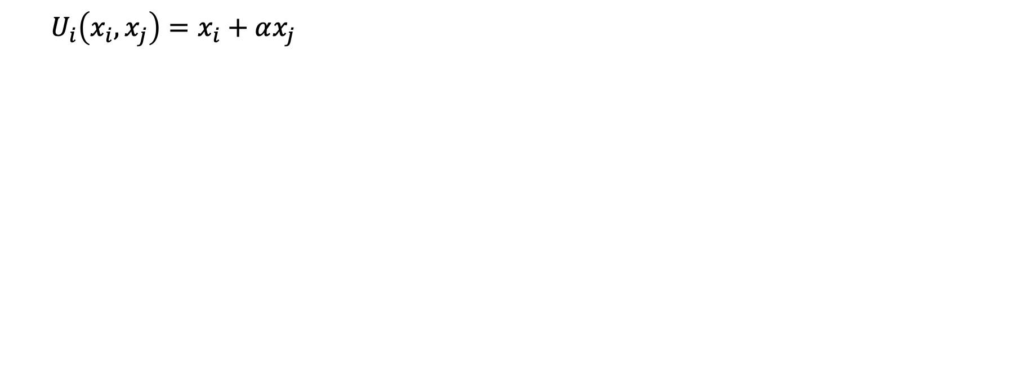
Altruism
$$U_{i}\left(x_{i},x_{j}\right)=x_{i}+αx_{j}$$

Slide 8
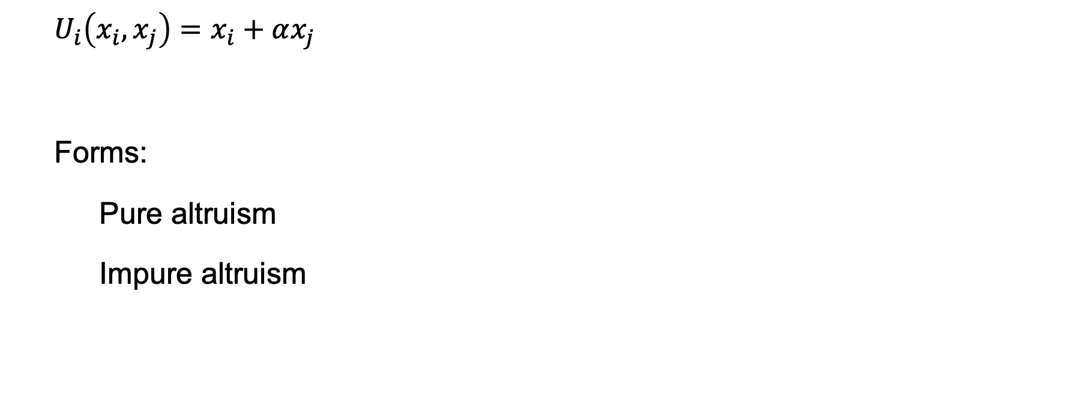
Altruism
$$U_{i}\left(x_{i},x_{j}\right)=x_{i}+αx_{j}$$
Forms:
Pure altruism
Impure altruism

Slide 9
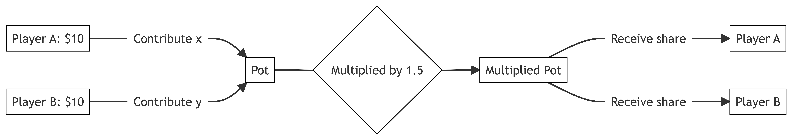
Example: the public goods game

Slide 10
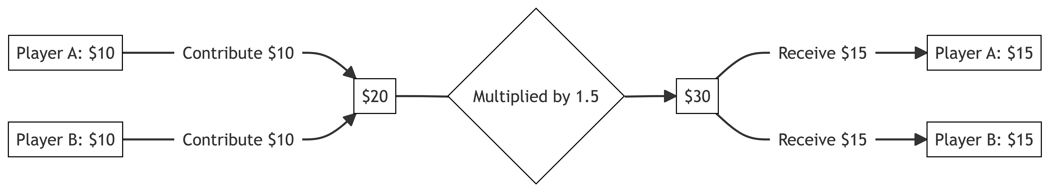
Example: the public goods game - cooperation

Slide 11
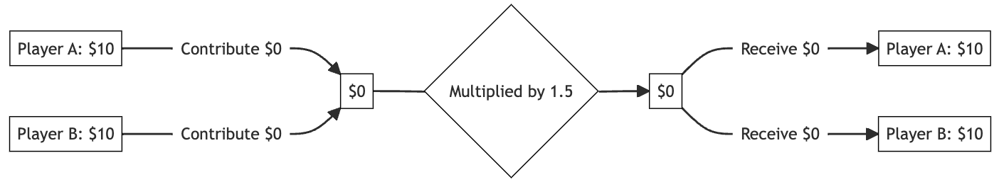
Example: the public goods game – no cooperation

Slide 12
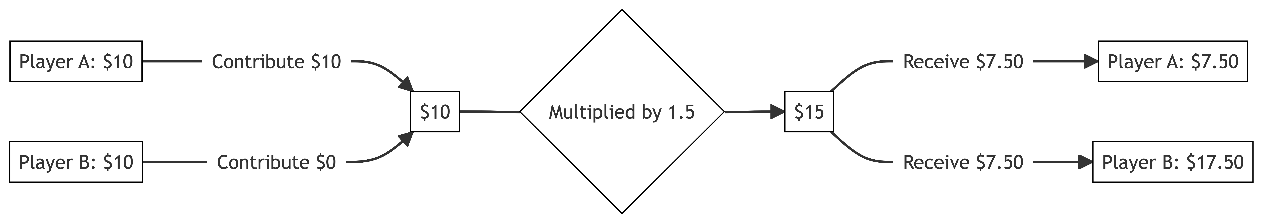
Example: the public goods game - defection

Slide 13
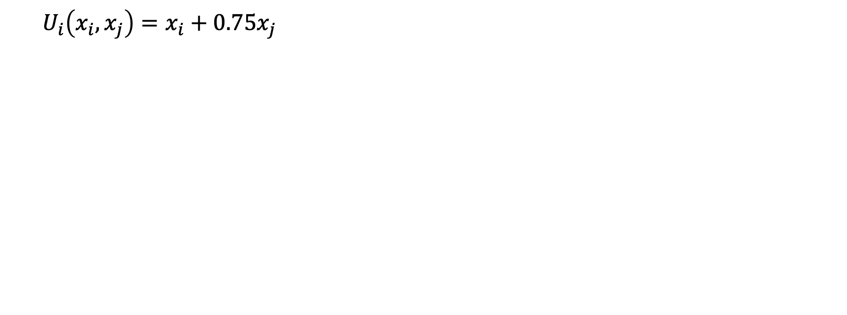
Example: the public goods game
$$U_{i}\left(x_{i},x_{j}\right)=x_{i}+0.75x_{j}$$

Slide 14
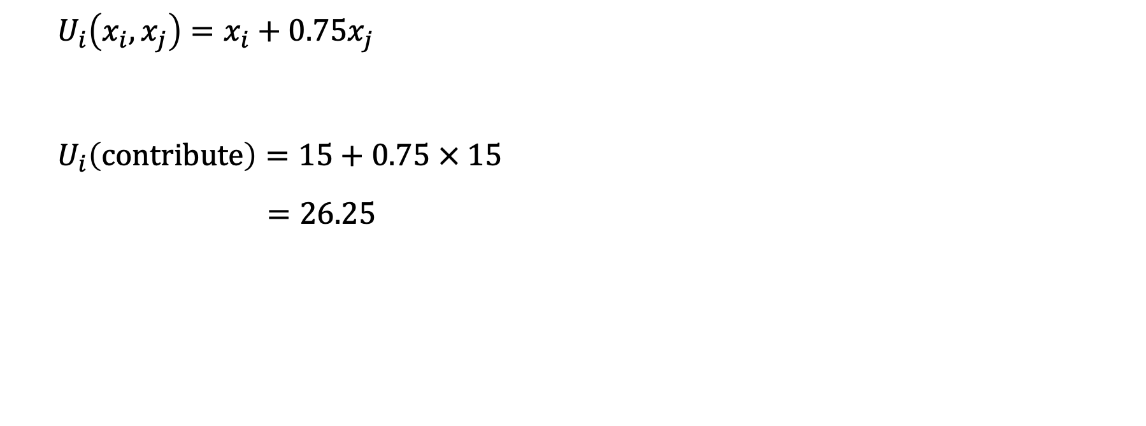
Example: the public goods game
$$U_{i}\left(x_{i},x_{j}\right)=x_{i}+0.75x_{j}$$
$$U_{i}\left(contribute\right)=15+0.75 × 15$$
$$=26.25$$

Slide 15
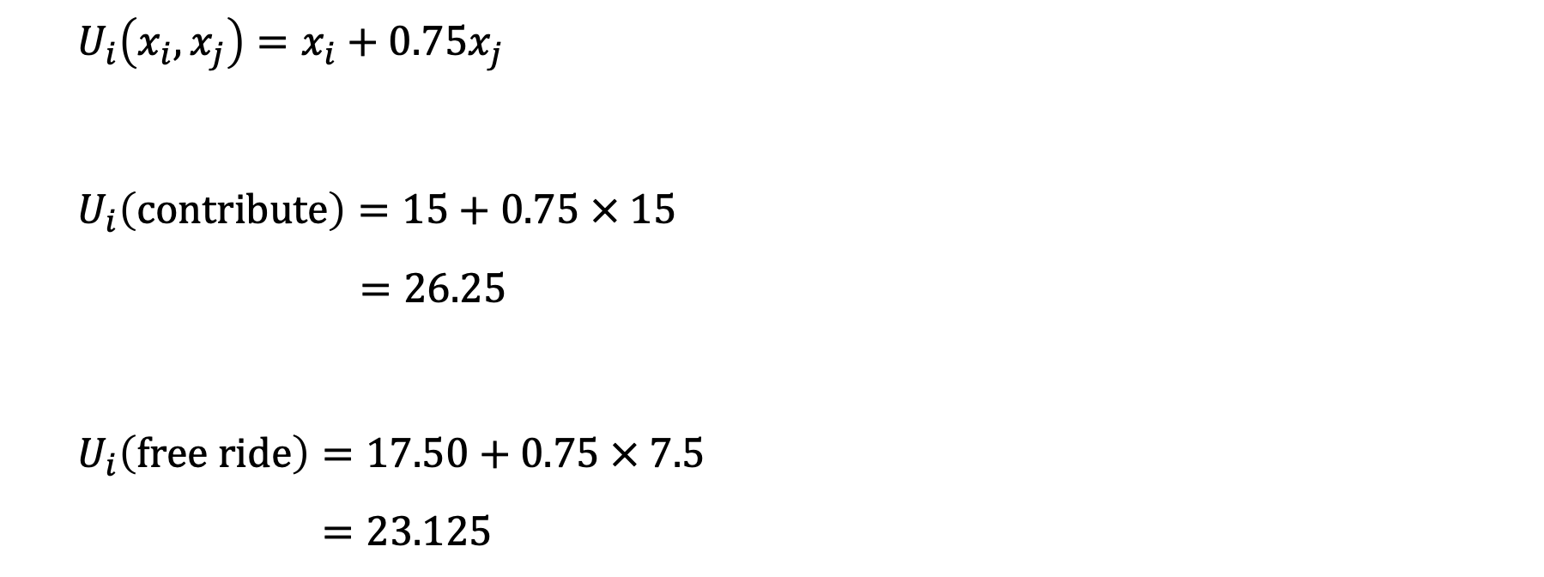
Example: the public goods game
$$U_{i}\left(x_{i},x_{j}\right)=x_{i}+0.75x_{j}$$
$$U_{i}\left(contribute\right)=15+0.75 × 15$$
$$=26.25$$
$$U_{i}\left(free ride\right)=17.50+0.75 × 7.5$$
$$=23.125$$

Slide 16
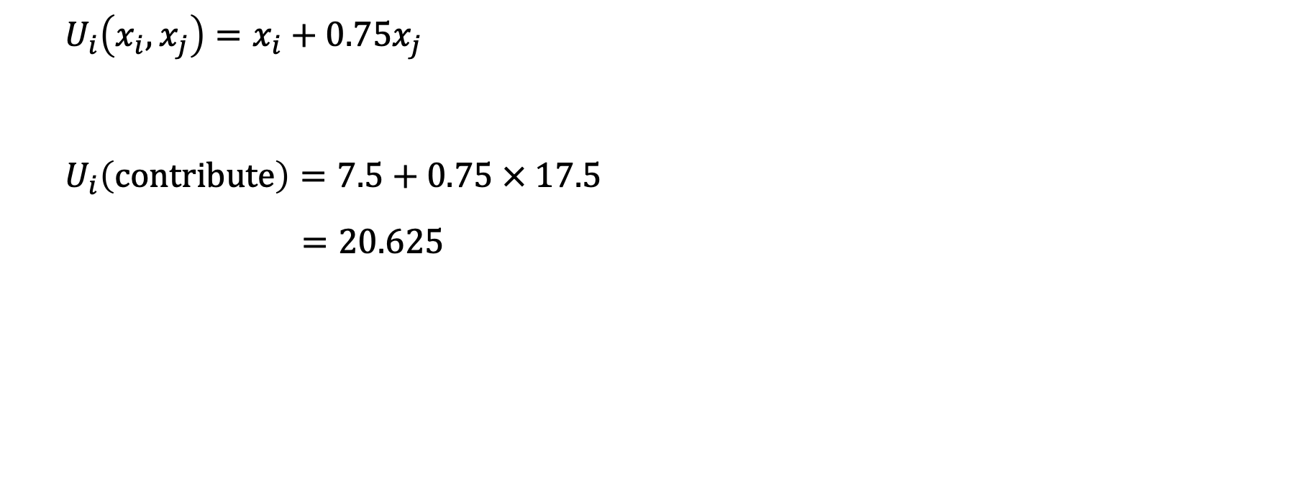
Example: the public goods game
$$U_{i}\left(x_{i},x_{j}\right)=x_{i}+0.75x_{j}$$
$$U_{i}\left(contribute\right)=7.5+0.75 × 17.5$$
$$=20.625$$

Slide 17
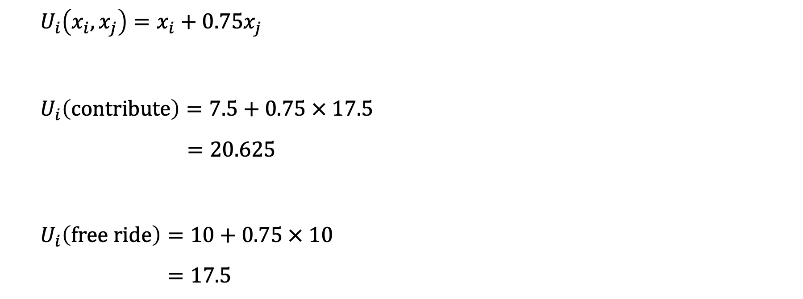
Example: the public goods game
$$U_{i}\left(x_{i},x_{j}\right)=x_{i}+0.75x_{j}$$
$$U_{i}\left(contribute\right)=7.5+0.75 × 17.5$$
$$=20.625$$
$$U_{i}\left(free ride\right)=10+0.75 × 10$$
$$=17.5$$

Slide 18
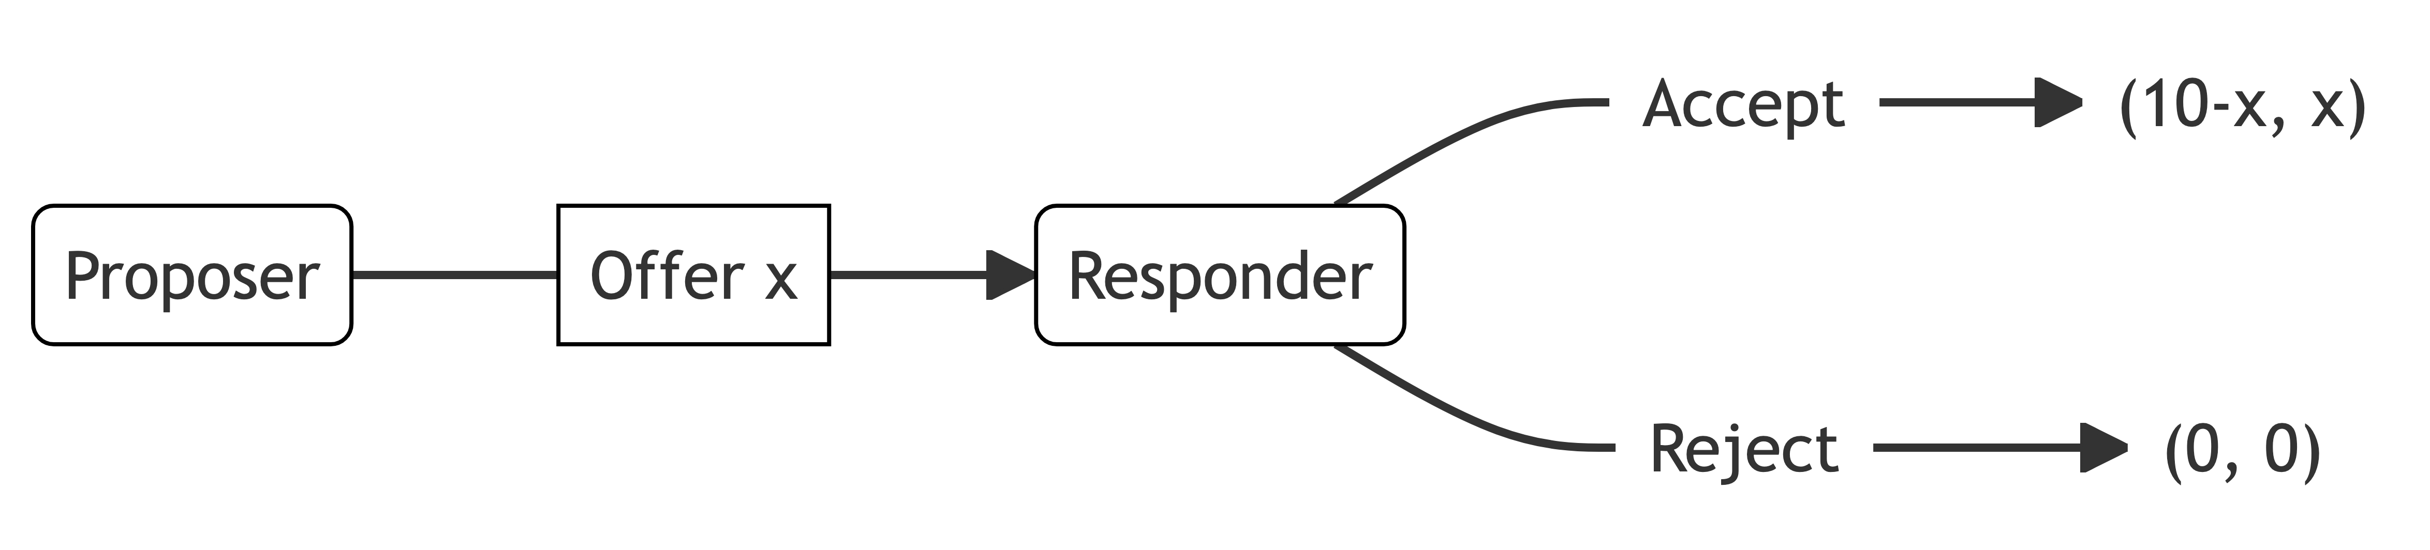
Limitations of the altruism model

Slide 19

Inequality aversion

Slide 20
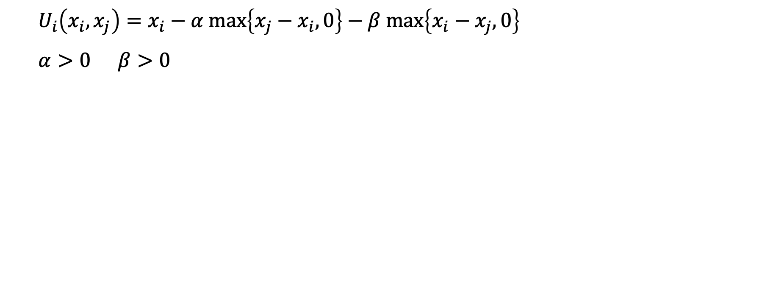
Inequality aversion
$$U_{i}\left(x_{i},x_{j}\right)=x_{i}−α \text{max}\left\{x_{j}−x_{i},0\right\}−β \text{max}\left\{x_{i}−x_{j},0\right\}$$
$$α>0 β>0$$

Slide 21
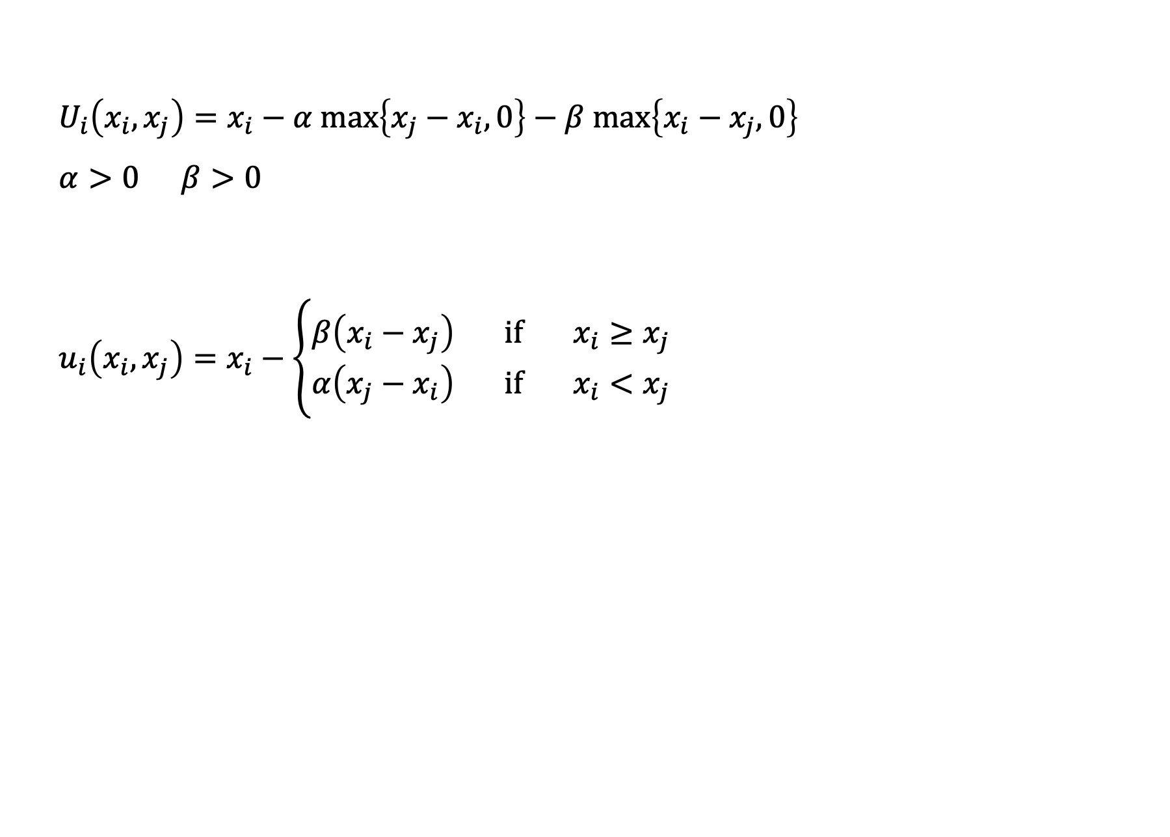
Inequality aversion
$$U_{i}\left(x_{i},x_{j}\right)=x_{i}−α \text{max}\left\{x_{j}−x_{i},0\right\}−β \text{max}\left\{x_{i}−x_{j},0\right\}$$
$$α>0 β>0$$
$$u_{i}\left(x_{i},x_{j}\right)=x_{i}−\left\{\begin{aligned}β\left(x_{i}−x_{j}\right) if { x}_{i}≥x_{j} \\ α\left(x_{j}−x_{i}\right) if x_{i}<x_{j}\end{aligned}\right.$$

Slide 22
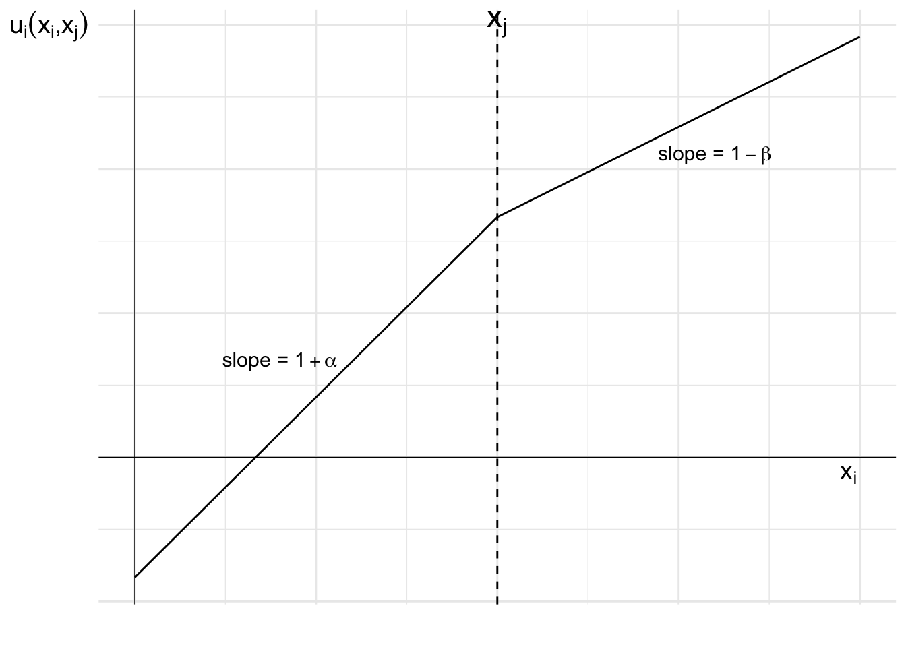
Inequality aversion

Slide 23
Example: the ultimatum game

Slide 24
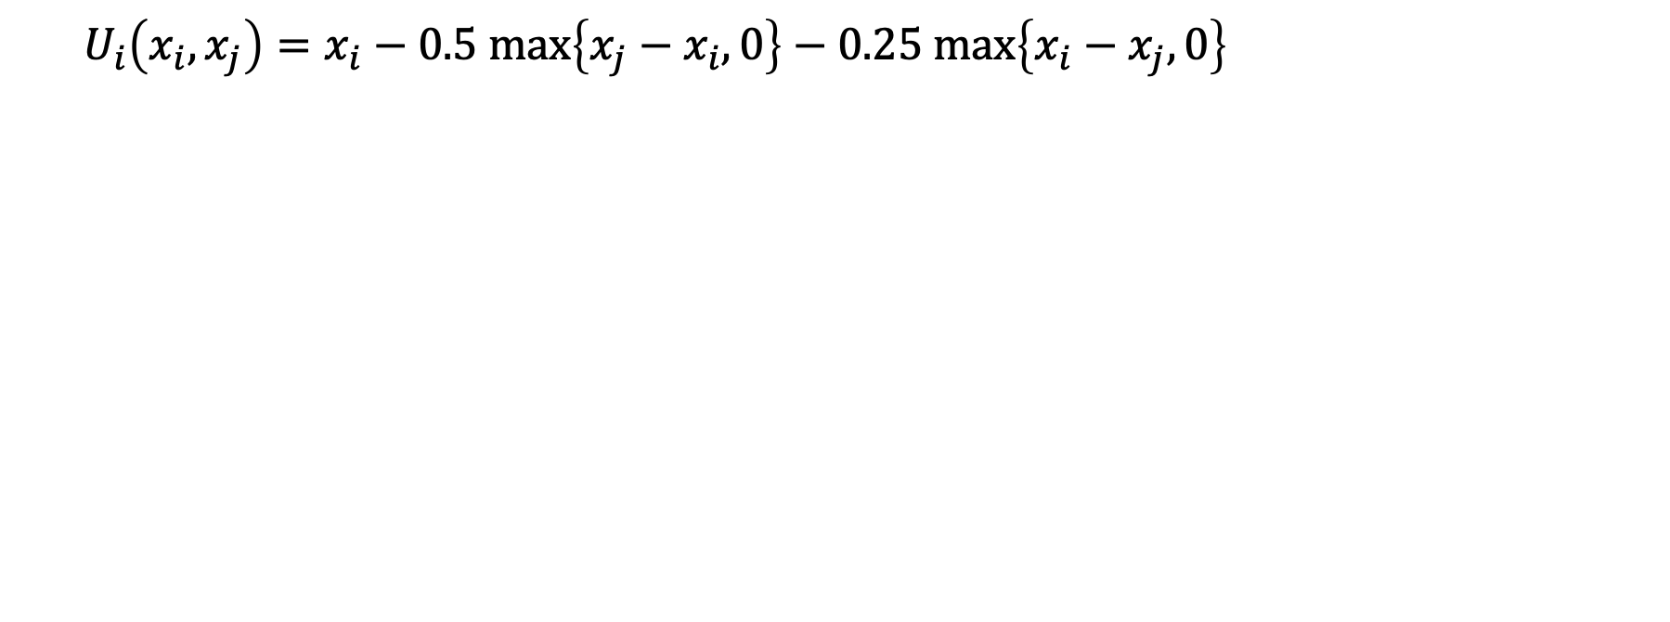
Example: the ultimatum game
$$U_{i}\left(x_{i},x_{j}\right)=x_{i}−0.5 \text{max}\left\{x_{j}−x_{i},0\right\}−0.25 \text{max}\left\{x_{i}−x_{j},0\right\}$$

Slide 25
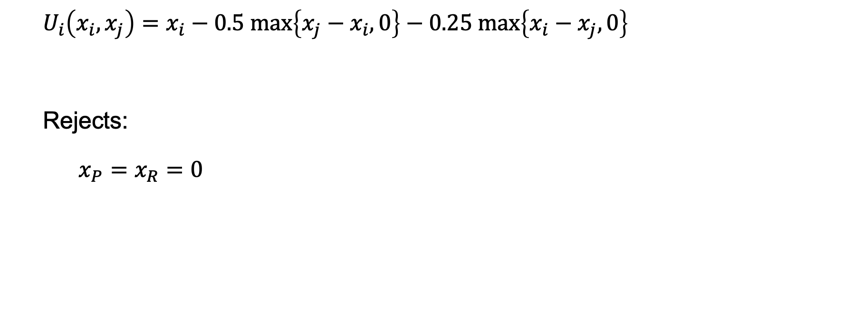
Example: the ultimatum game
$$U_{i}\left(x_{i},x_{j}\right)=x_{i}−0.5 \text{max}\left\{x_{j}−x_{i},0\right\}−0.25 \text{max}\left\{x_{i}−x_{j},0\right\}$$
Rejects:
$x_{P}=x_{R}=0$

Slide 26
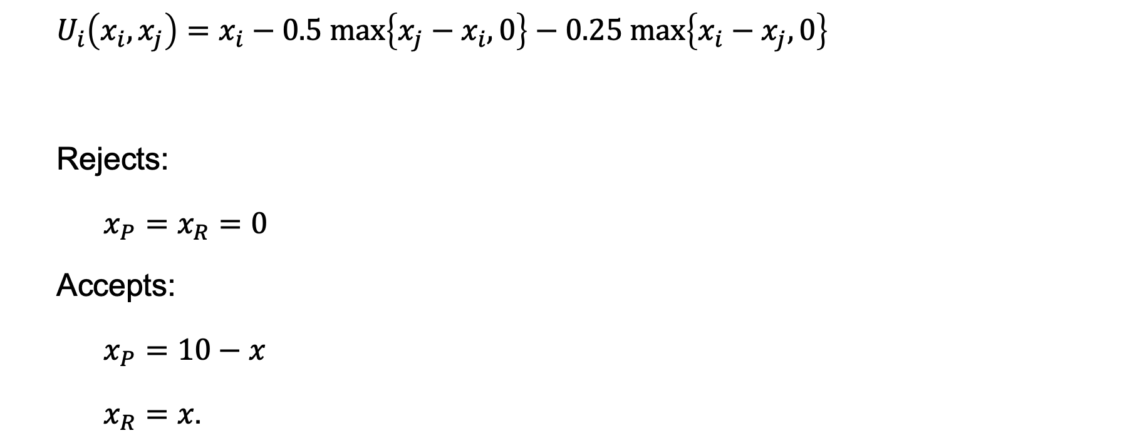
Example: the ultimatum game
$$U_{i}\left(x_{i},x_{j}\right)=x_{i}−0.5 \text{max}\left\{x_{j}−x_{i},0\right\}−0.25 \text{max}\left\{x_{i}−x_{j},0\right\}$$
Rejects:
$x_{P}=x_{R}=0$
Accepts:
$x_{P}=10−x$
$x_{R}=x\text{.}$

Slide 27
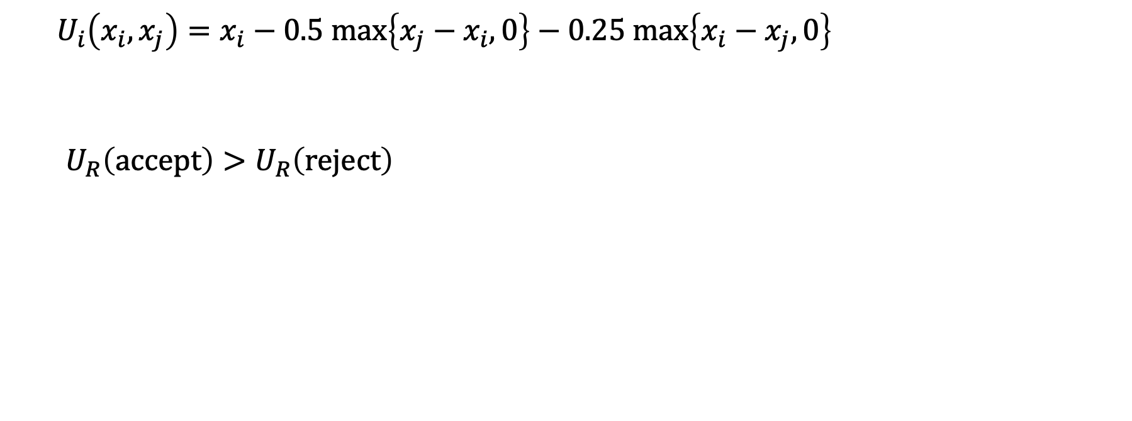
Example: the ultimatum game
$$U_{i}\left(x_{i},x_{j}\right)=x_{i}−0.5 \text{max}\left\{x_{j}−x_{i},0\right\}−0.25 \text{max}\left\{x_{i}−x_{j},0\right\}$$
$U_{R}\left(\text{accept}\right)>U_{R}\left(\text{reject}\right)$

Slide 28
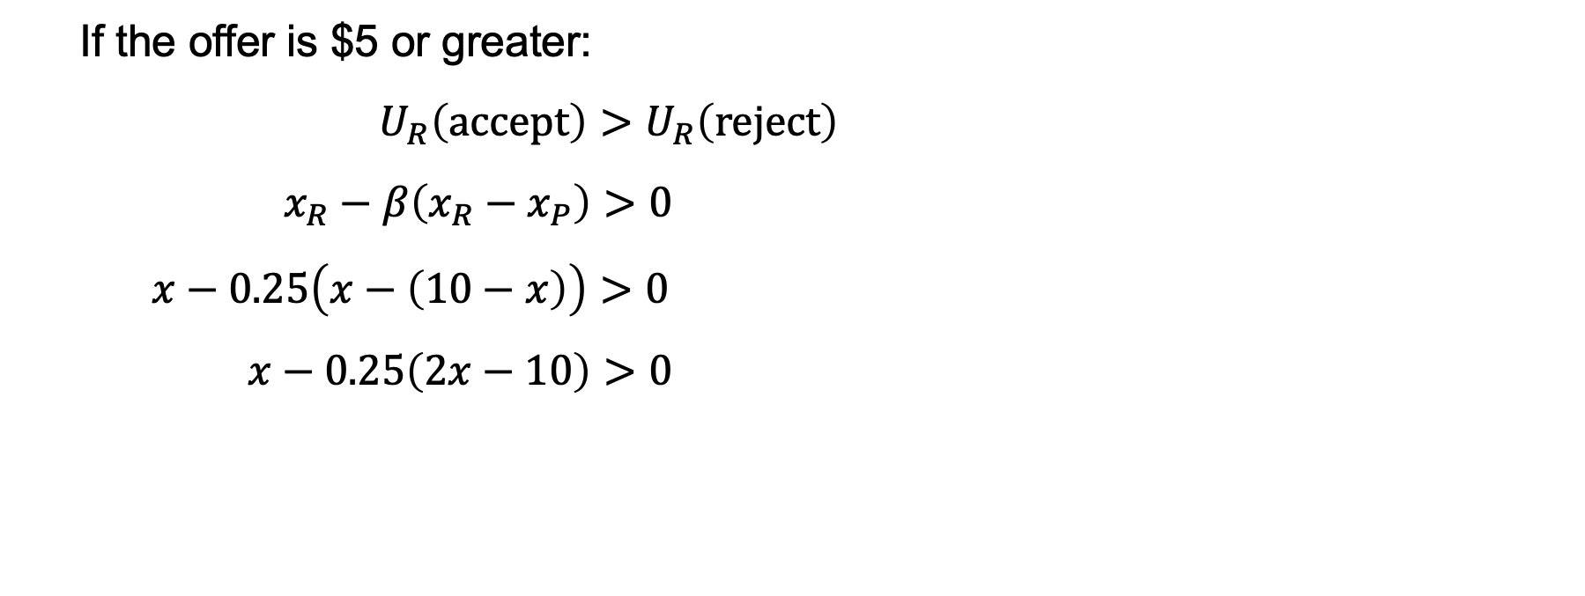
Example: the ultimatum game
If the offer is $5 or greater:
$U_{R}\left(\text{accept}\right)>U_{R}\left(\text{reject}\right)$
$x_{R}−β\left(x_{R}−x_{P}\right)>0$
$x−0.25\left(x−\left(10−x\right)\right)>0$
$x−0.25\left(2x−10\right)>0$

Slide 29
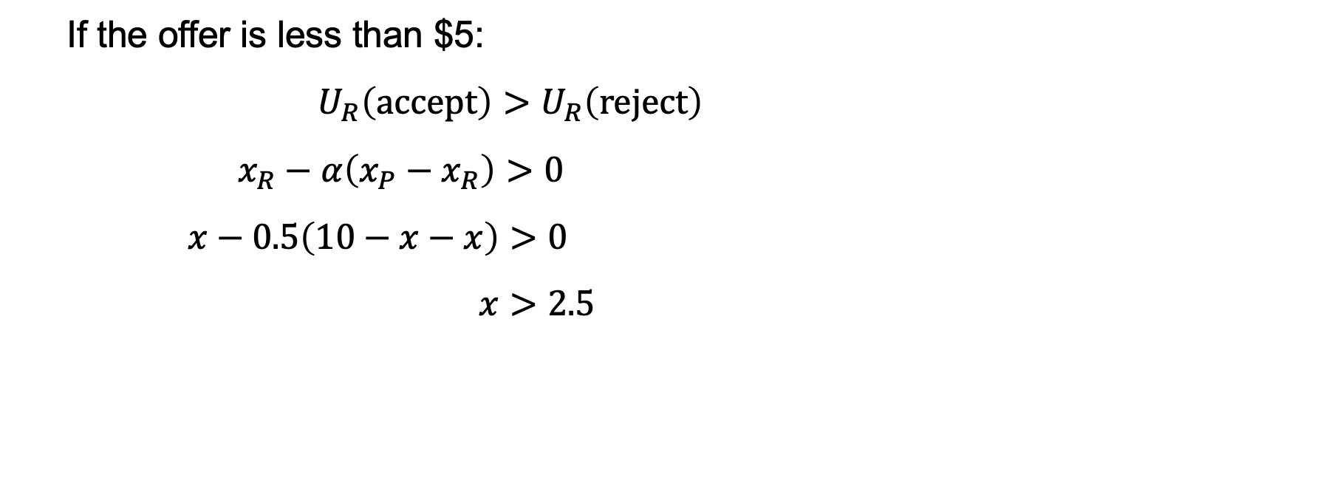
Example: the ultimatum game
If the offer is less than $5:
$U_{R}\left(\text{accept}\right)>U_{R}\left(\text{reject}\right)$
$x_{R}−α\left(x_{P}−x_{R}\right)>0$
$x−0.5\left(10−x−x\right)>0$
$x>2.5$

Slide 30
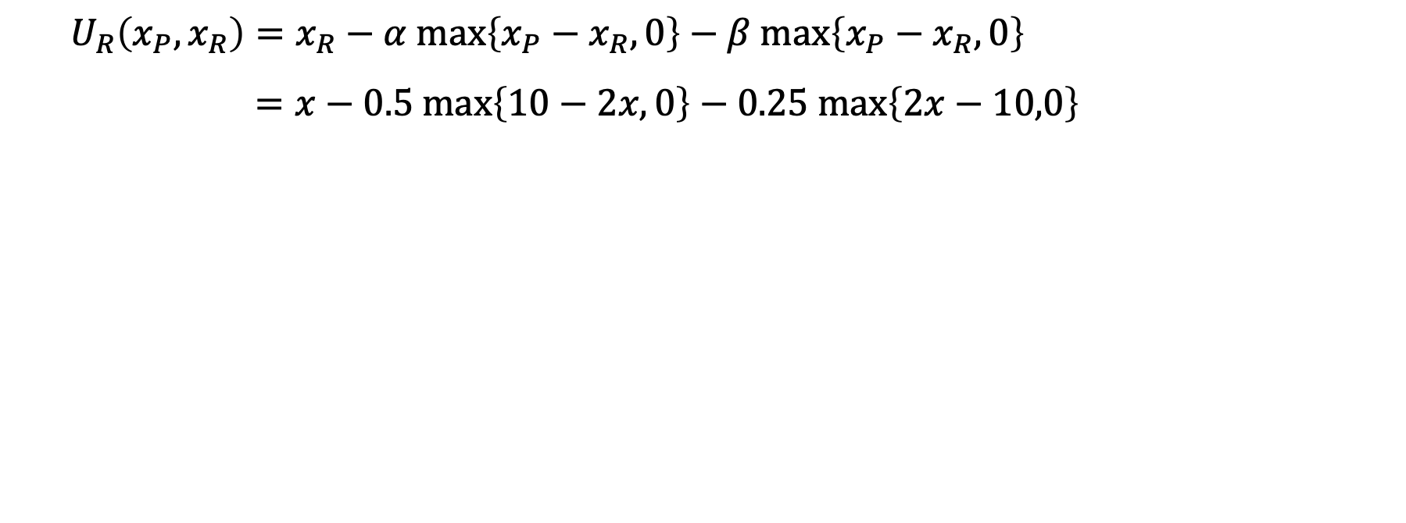
Example: the ultimatum game
$$U_{R}\left(x_{P},x_{R}\right)=x_{R}−α \text{max}\left\{x_{P}−x_{R},0\right\}−β \text{max}\left\{x_{P}−x_{R},0\right\}$$
$$=x−0.5 \text{max}\left\{10−2x,0\right\}−0.25 \text{max}\left\{2x−10,0\right\}$$

Slide 31
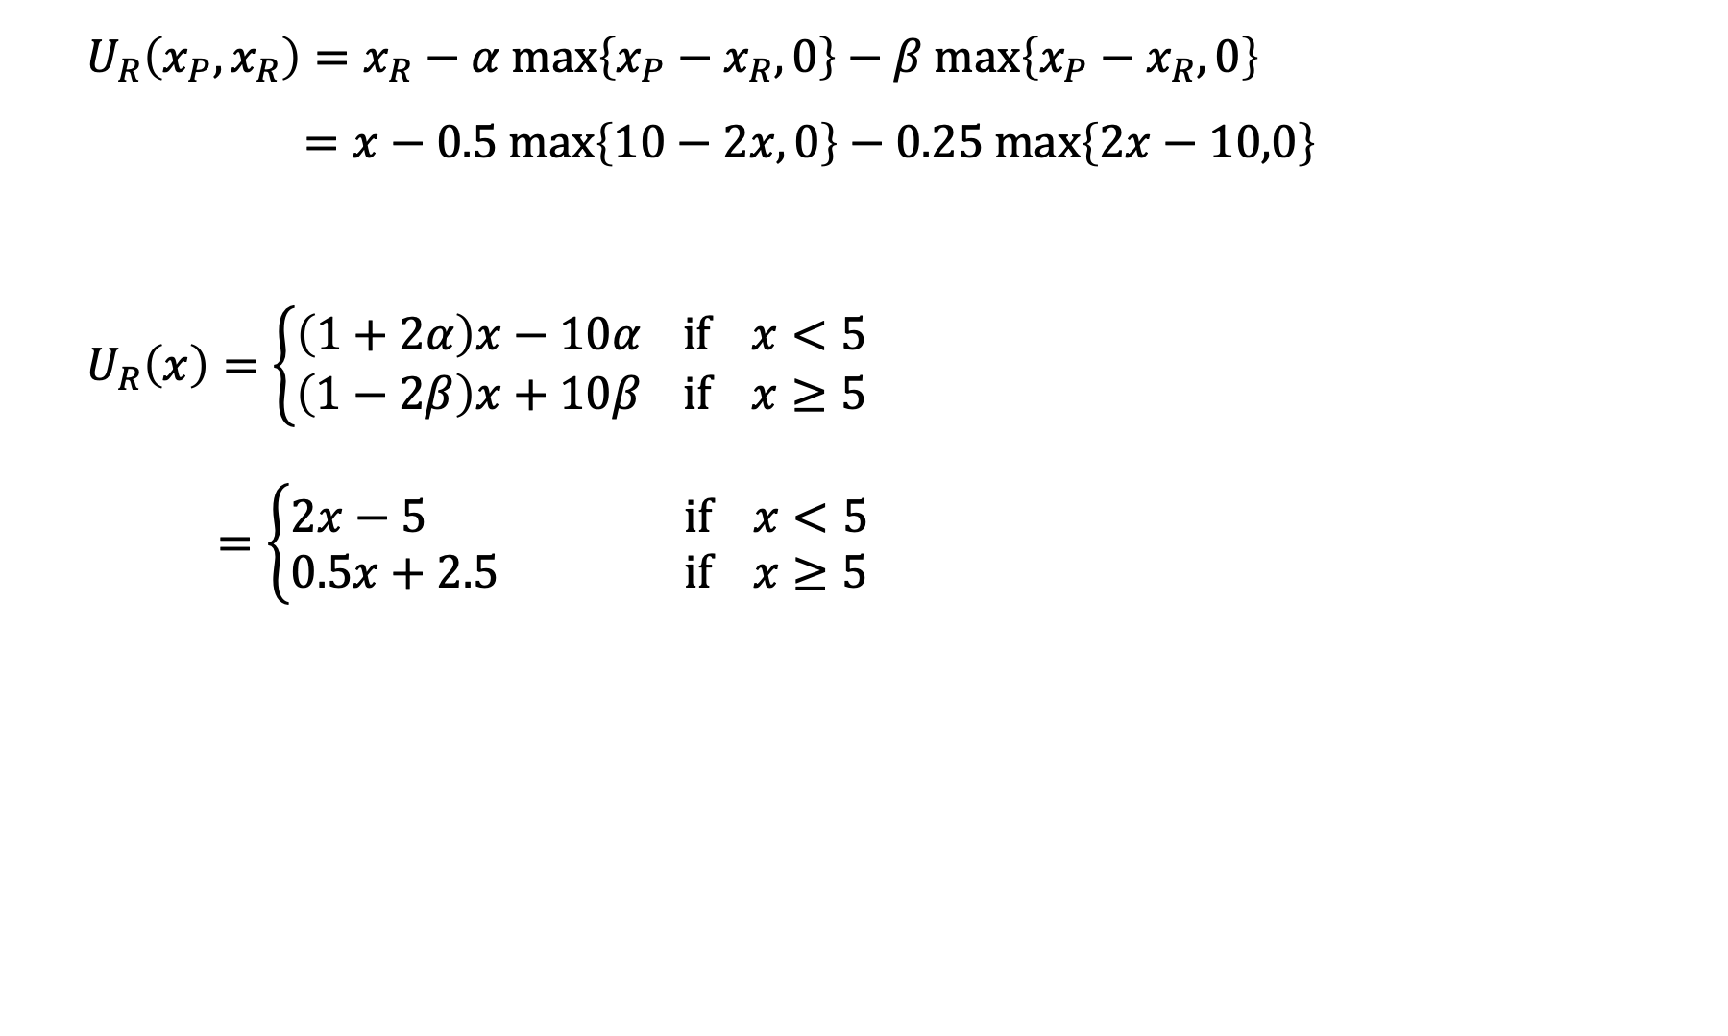
Example: the ultimatum game
$$U_{R}\left(x_{P},x_{R}\right)=x_{R}−α \text{max}\left\{x_{P}−x_{R},0\right\}−β \text{max}\left\{x_{P}−x_{R},0\right\}$$
$$=x−0.5 \text{max}\left\{10−2x,0\right\}−0.25 \text{max}\left\{2x−10,0\right\}$$
$$U_{R}\left(x\right)=\left\{\begin{aligned}\left(1+2α\right)x−10α \text{if} x<5 \\ \left(1−2β\right)x+10β \text{if} x≥5\end{aligned}\right.$$
$=\left\{\begin{aligned}2x−5 \text{if} x<5 \\ 0.5x+2.5 \text{if} x≥5\end{aligned}\right.$

Slide 32
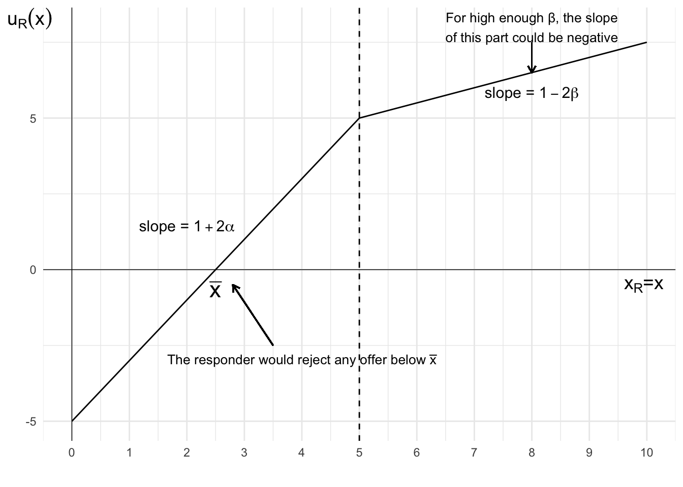
Example: the ultimatum game

Slide 33
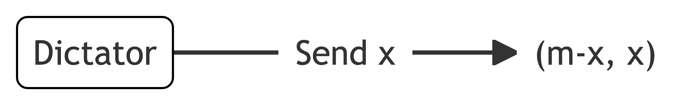
Example: the dictator game

Slide 34
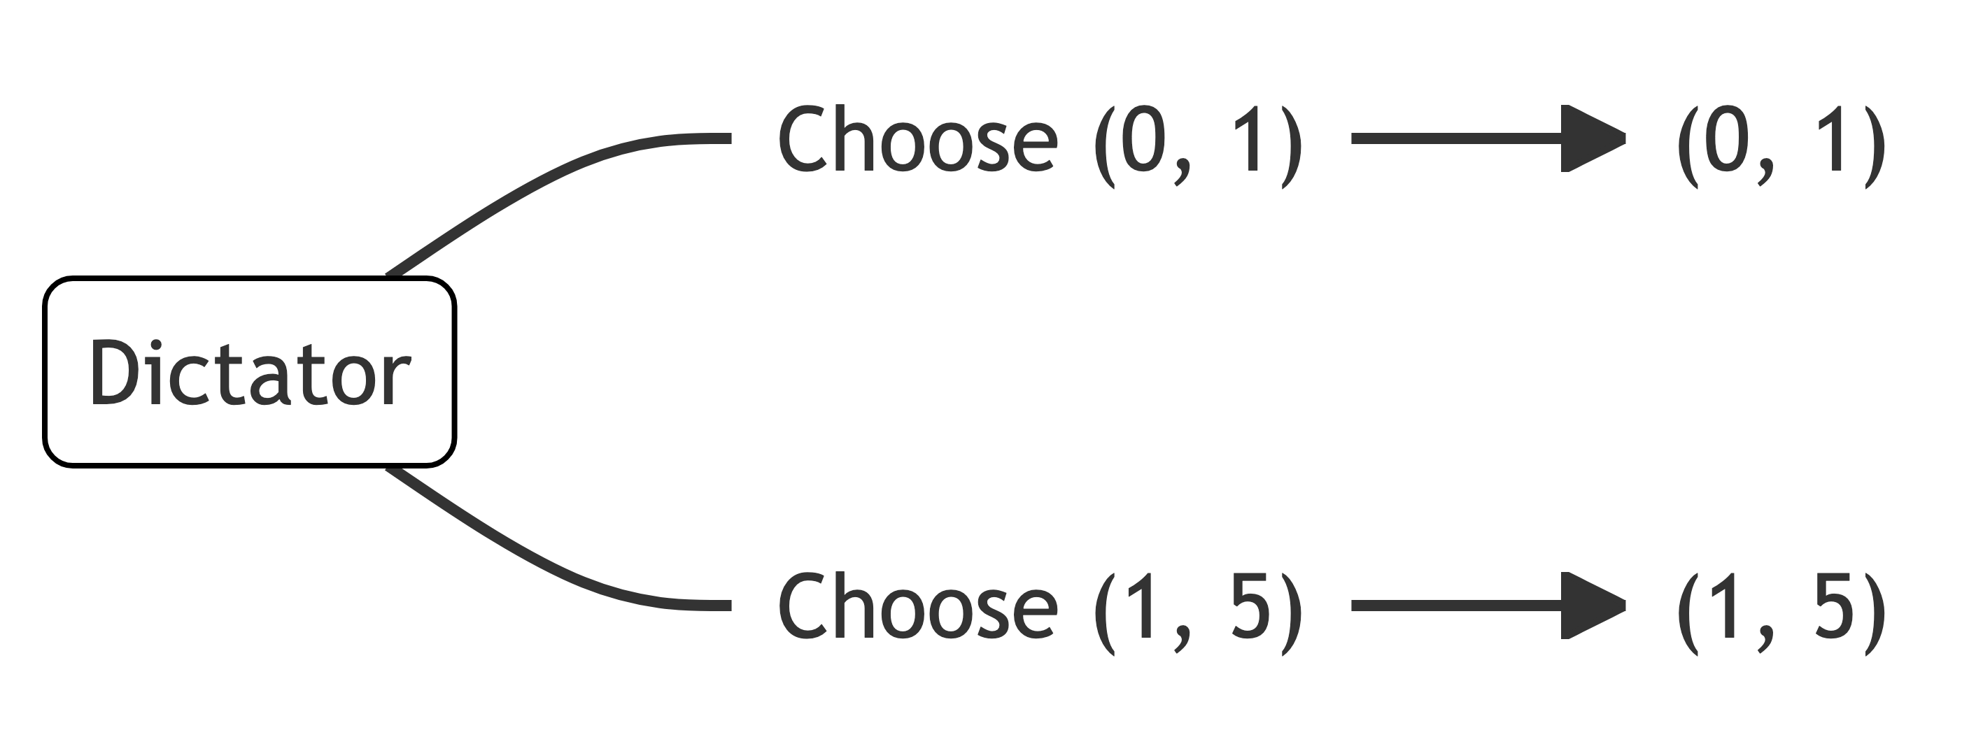
Example: the dictator game

Slide 35
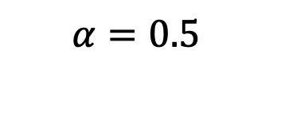
Example: the dictator game
$$α=0.5$$

Slide 36
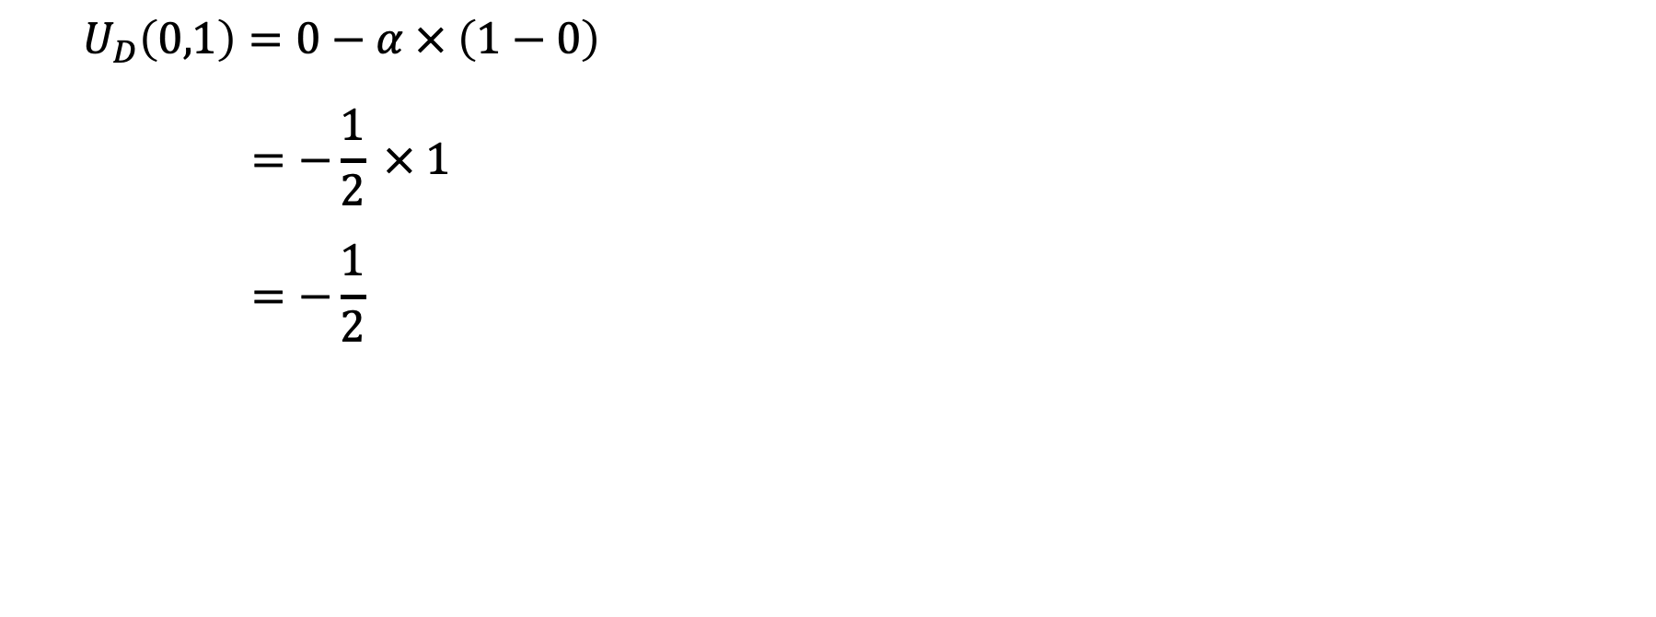
Example: the dictator game
$$U_{D}\left(0,1\right)=0−α × \left(1−0\right)$$
$$=−\frac{1}{2} × 1$$
$$=−\frac{1}{2}$$

Slide 37
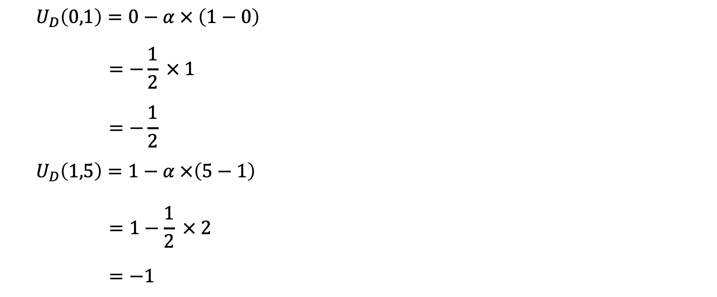
Example: the dictator game
$$U_{D}\left(0,1\right)=0−α × \left(1−0\right)$$
$$=−\frac{1}{2} × 1$$
$$=−\frac{1}{2}$$
$$U_{D}\left(1,5\right)=1−α ×\left(5−1\right)$$
$$=1−\frac{1}{2} × 2$$
$$=−1$$

Slide 38
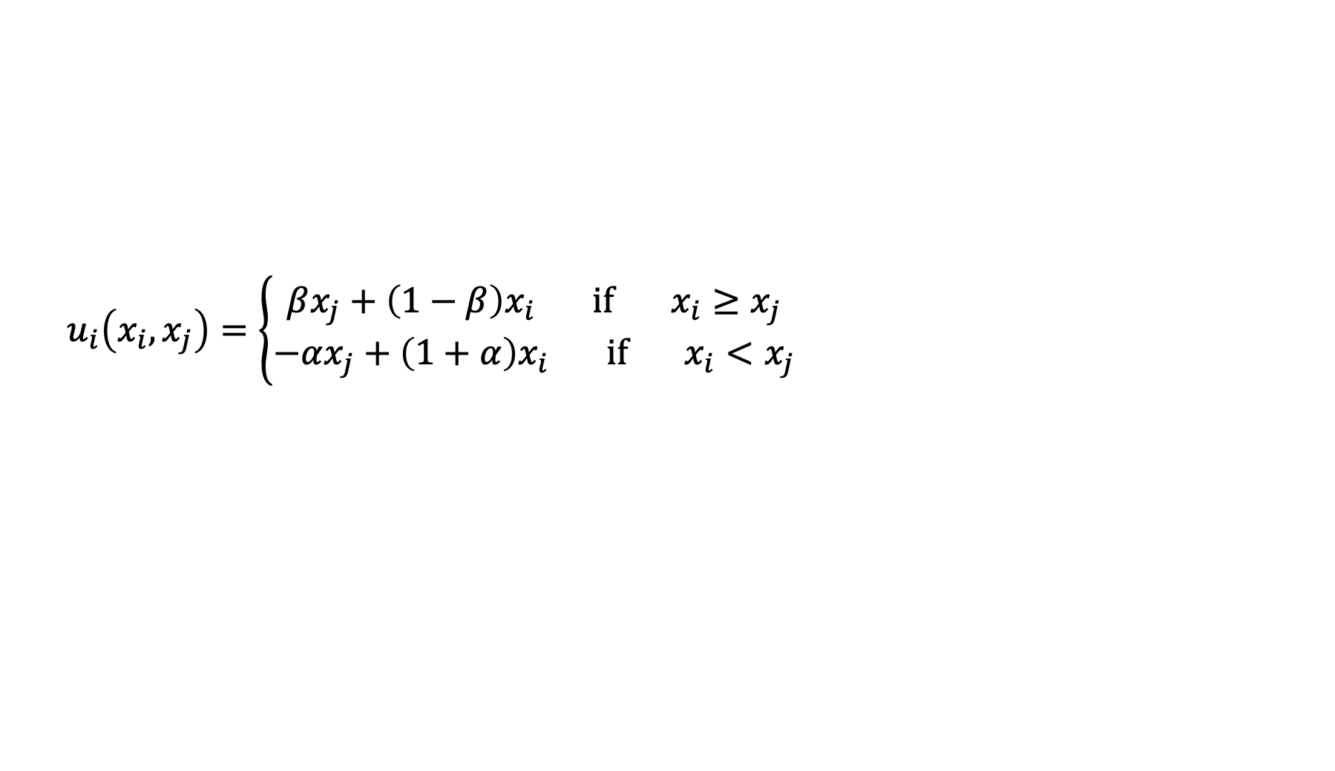
Other distributional preferences
$$u_{i}\left(x_{i},x_{j}\right)=\left\{\begin{aligned}βx_{j}+\left(1−β\right)x_{i} if { x}_{i}≥x_{j} \\ −αx_{j}+\left(1+α\right)x_{i} if x_{i}<x_{j}\end{aligned}\right.$$

Slide 39
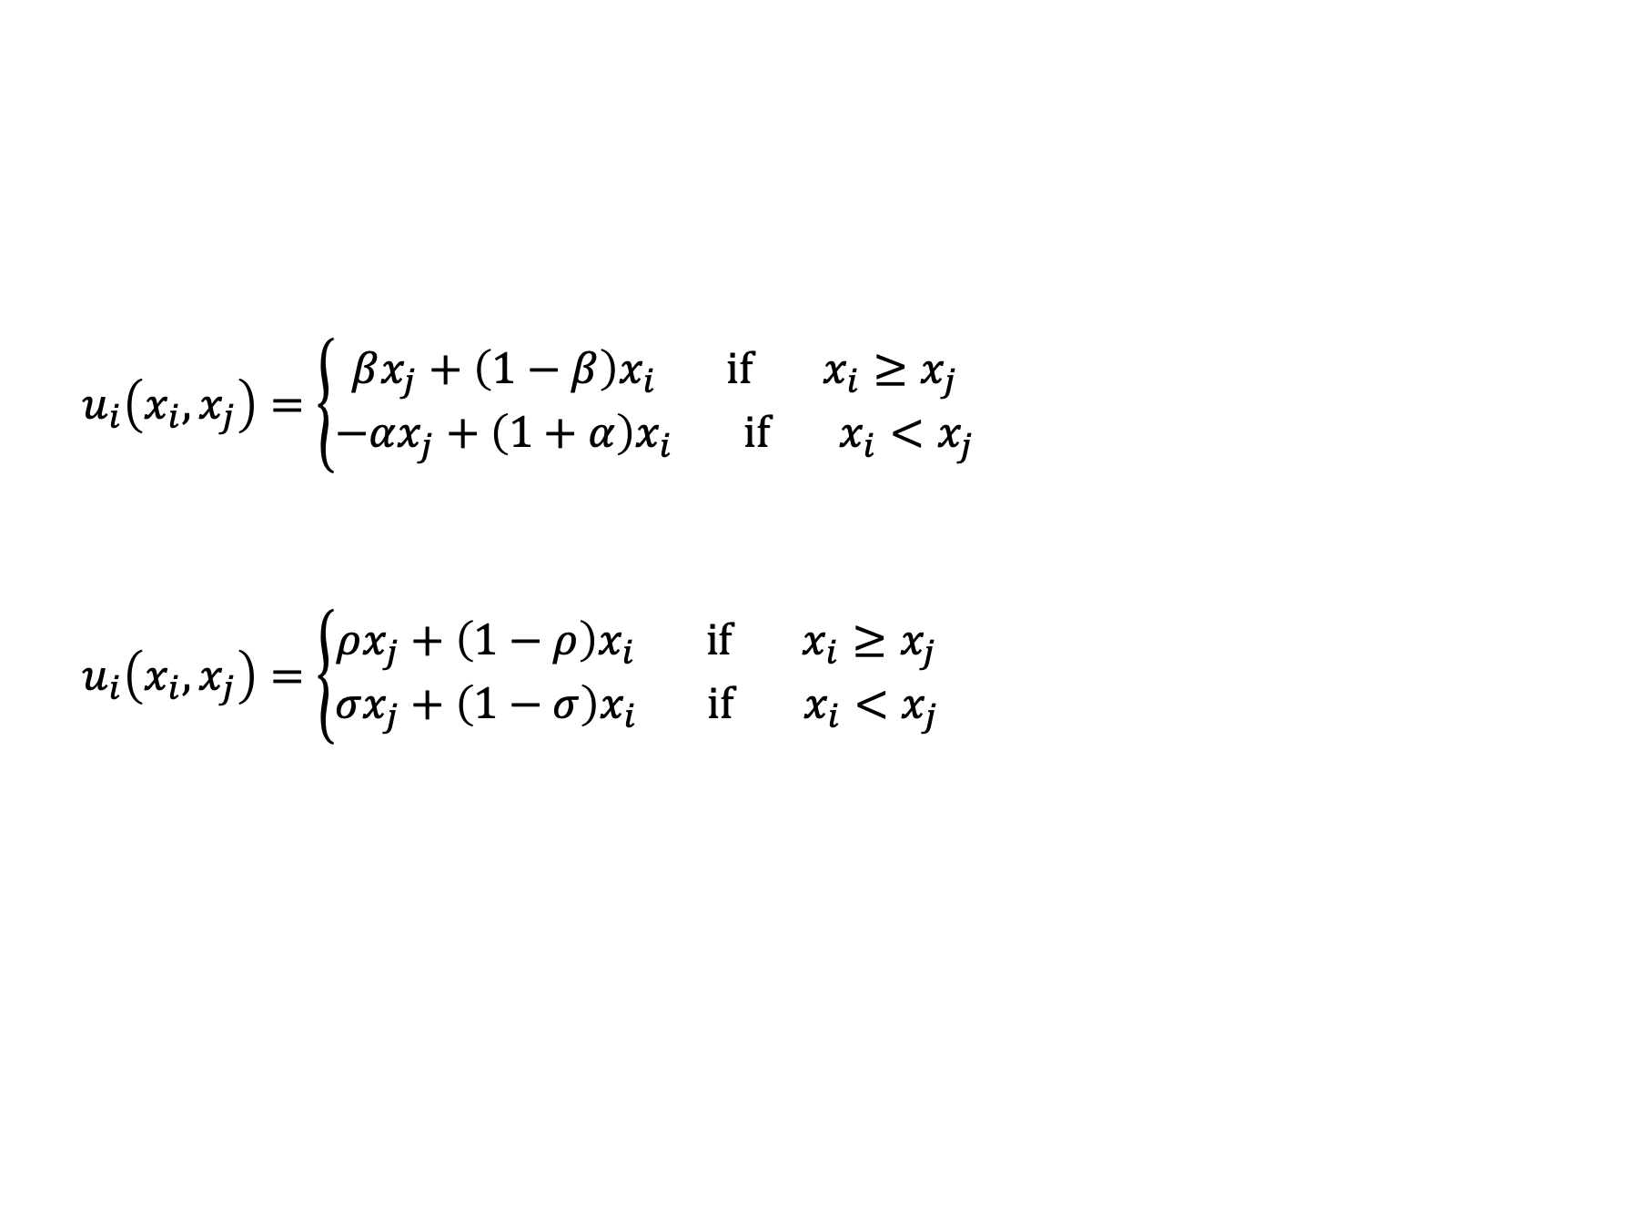
Other distributional preferences
$$u_{i}\left(x_{i},x_{j}\right)=\left\{\begin{aligned}βx_{j}+\left(1−β\right)x_{i} if { x}_{i}≥x_{j} \\ −αx_{j}+\left(1+α\right)x_{i} if x_{i}<x_{j}\end{aligned}\right.$$
$$u_{i}\left(x_{i},x_{j}\right)=\left\{\begin{aligned}ρx_{j}+\left(1−ρ\right)x_{i} if { x}_{i}≥x_{j} \\ σx_{j}+\left(1−σ\right)x_{i} if x_{i}<x_{j}\end{aligned}\right.$$

Slide 40
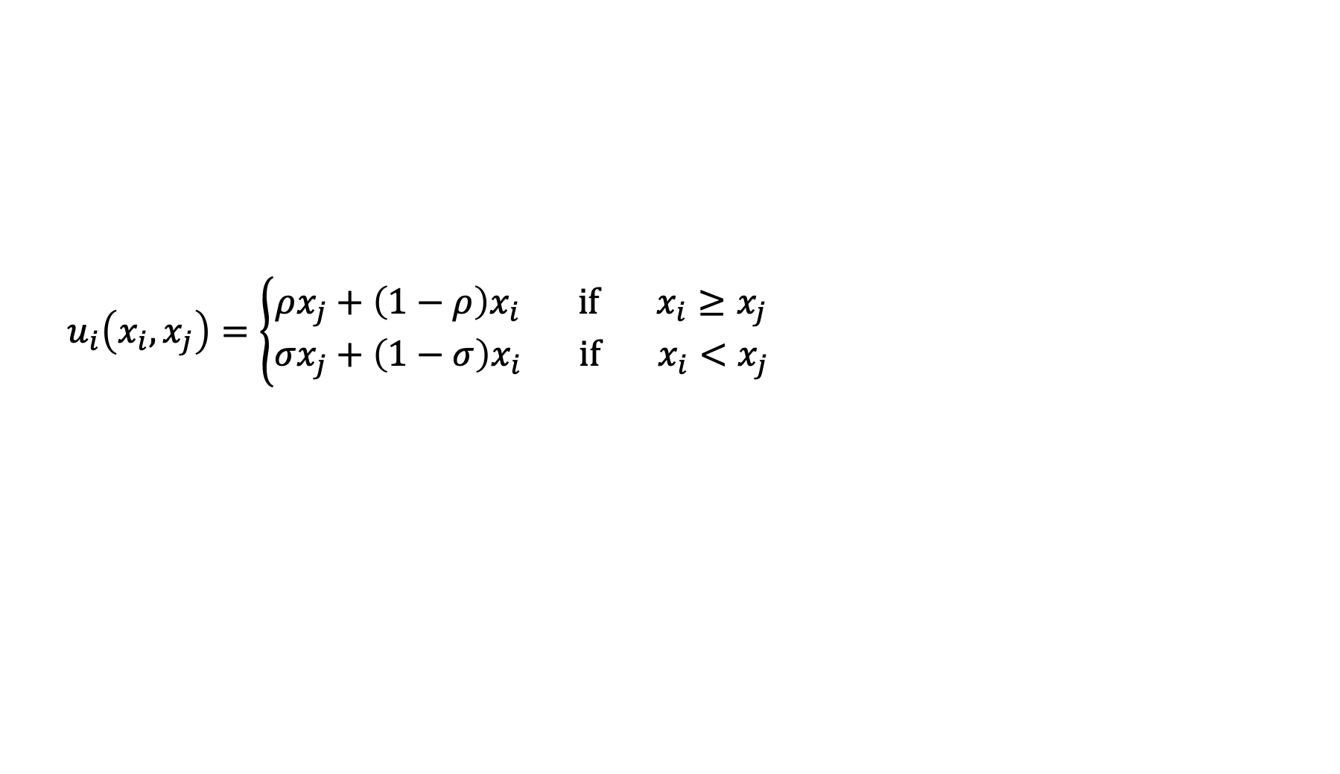
Other distributional preferences
$$u_{i}\left(x_{i},x_{j}\right)=\left\{\begin{aligned}ρx_{j}+\left(1−ρ\right)x_{i} if { x}_{i}≥x_{j} \\ σx_{j}+\left(1−σ\right)x_{i} if x_{i}<x_{j}\end{aligned}\right.$$

Slide 41
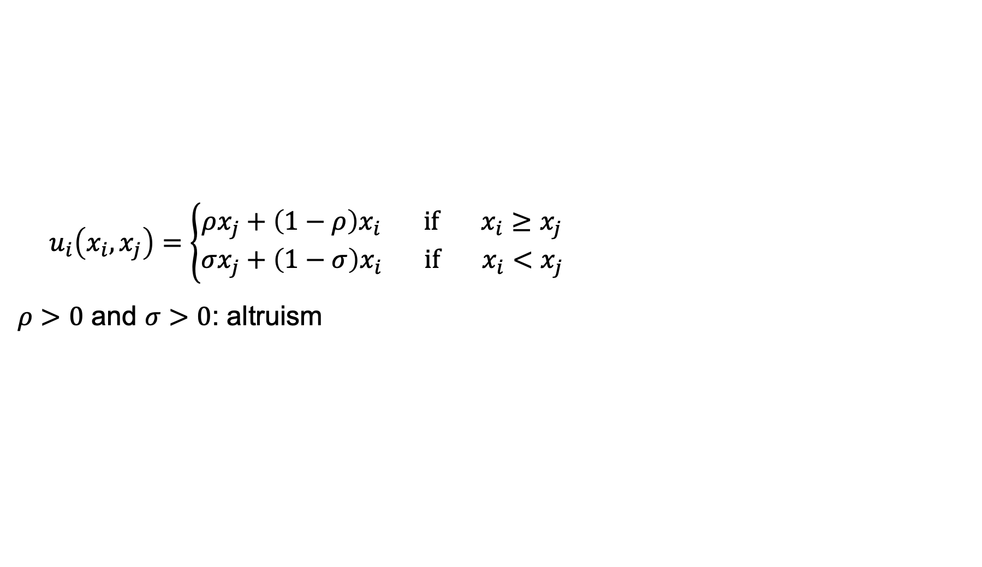
Other distributional preferences
$$u_{i}\left(x_{i},x_{j}\right)=\left\{\begin{aligned}ρx_{j}+\left(1−ρ\right)x_{i} if { x}_{i}≥x_{j} \\ σx_{j}+\left(1−σ\right)x_{i} if x_{i}<x_{j}\end{aligned}\right.$$
$ρ>0$ and $σ>0$: altruism

Slide 42
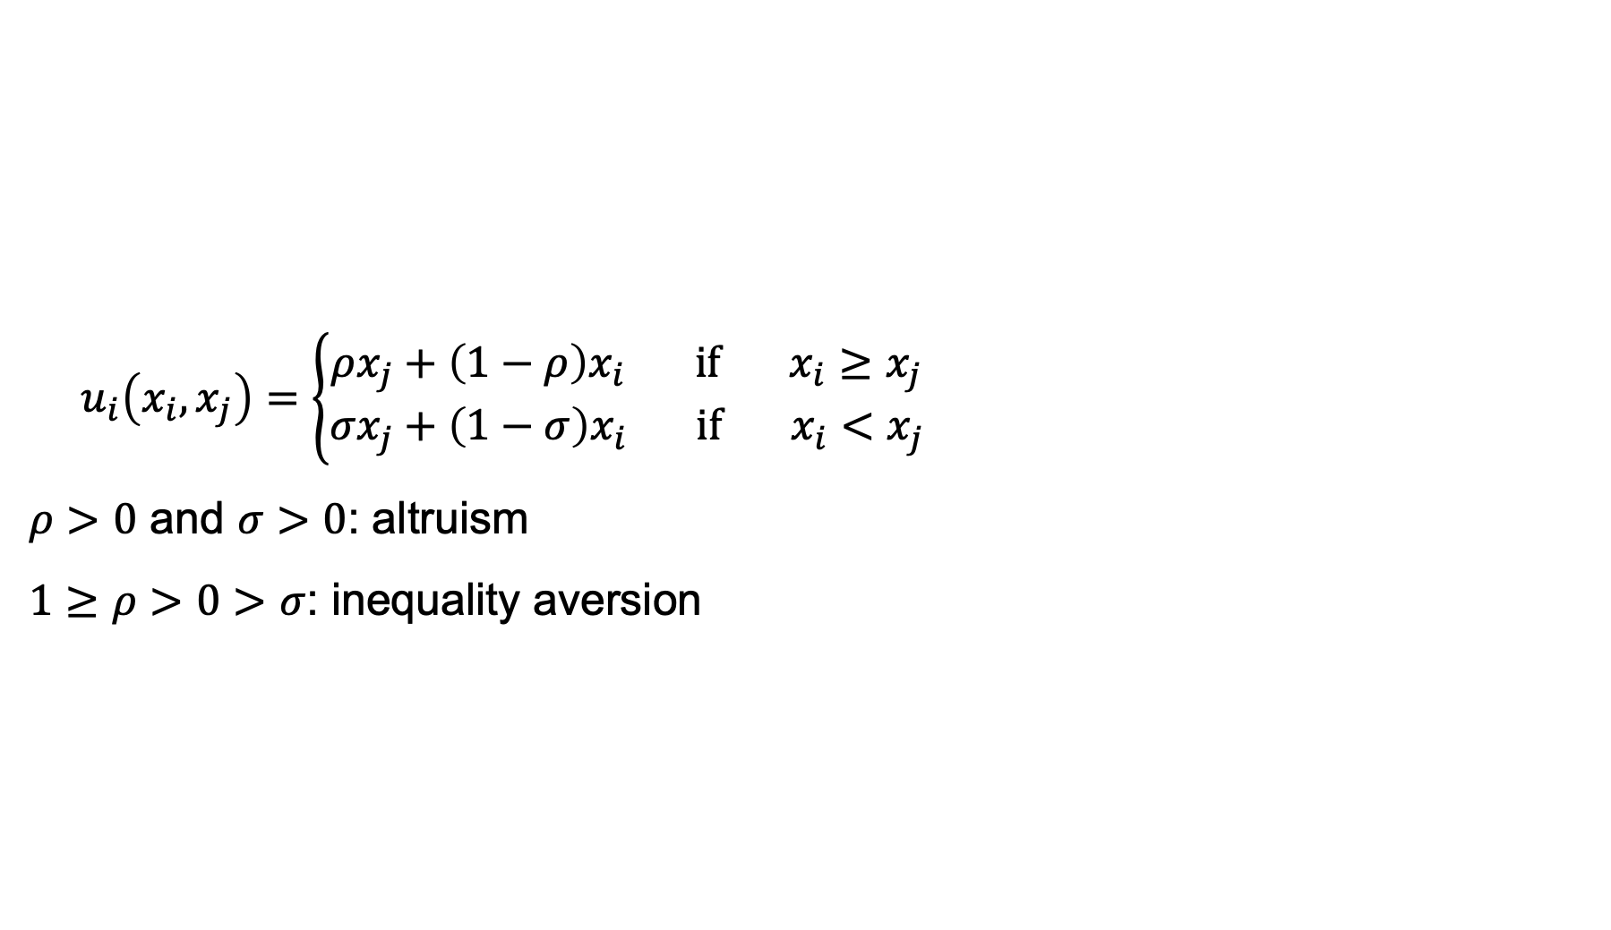
Other distributional preferences
$$u_{i}\left(x_{i},x_{j}\right)=\left\{\begin{aligned}ρx_{j}+\left(1−ρ\right)x_{i} if { x}_{i}≥x_{j} \\ σx_{j}+\left(1−σ\right)x_{i} if x_{i}<x_{j}\end{aligned}\right.$$
$ρ>0$ and $σ>0$: altruism
$1≥ρ>0>σ$: inequality aversion

Slide 43
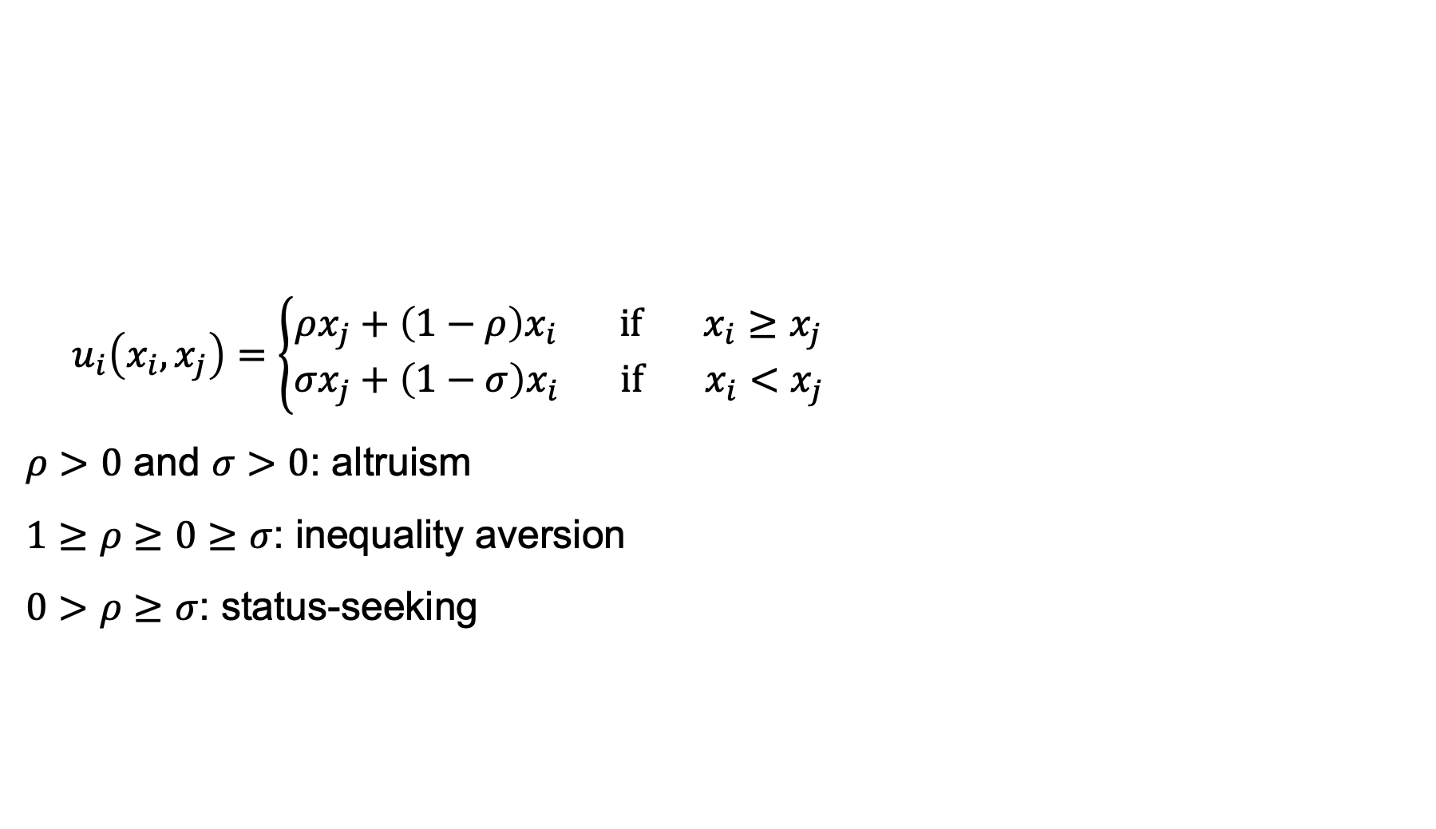
Other distributional preferences
$$u_{i}\left(x_{i},x_{j}\right)=\left\{\begin{aligned}ρx_{j}+\left(1−ρ\right)x_{i} if { x}_{i}≥x_{j} \\ σx_{j}+\left(1−σ\right)x_{i} if x_{i}<x_{j}\end{aligned}\right.$$
$ρ>0$ and $σ>0$: altruism
$1≥ρ≥0≥σ$: inequality aversion
$0>ρ≥σ$: status-seeking

Slide 44
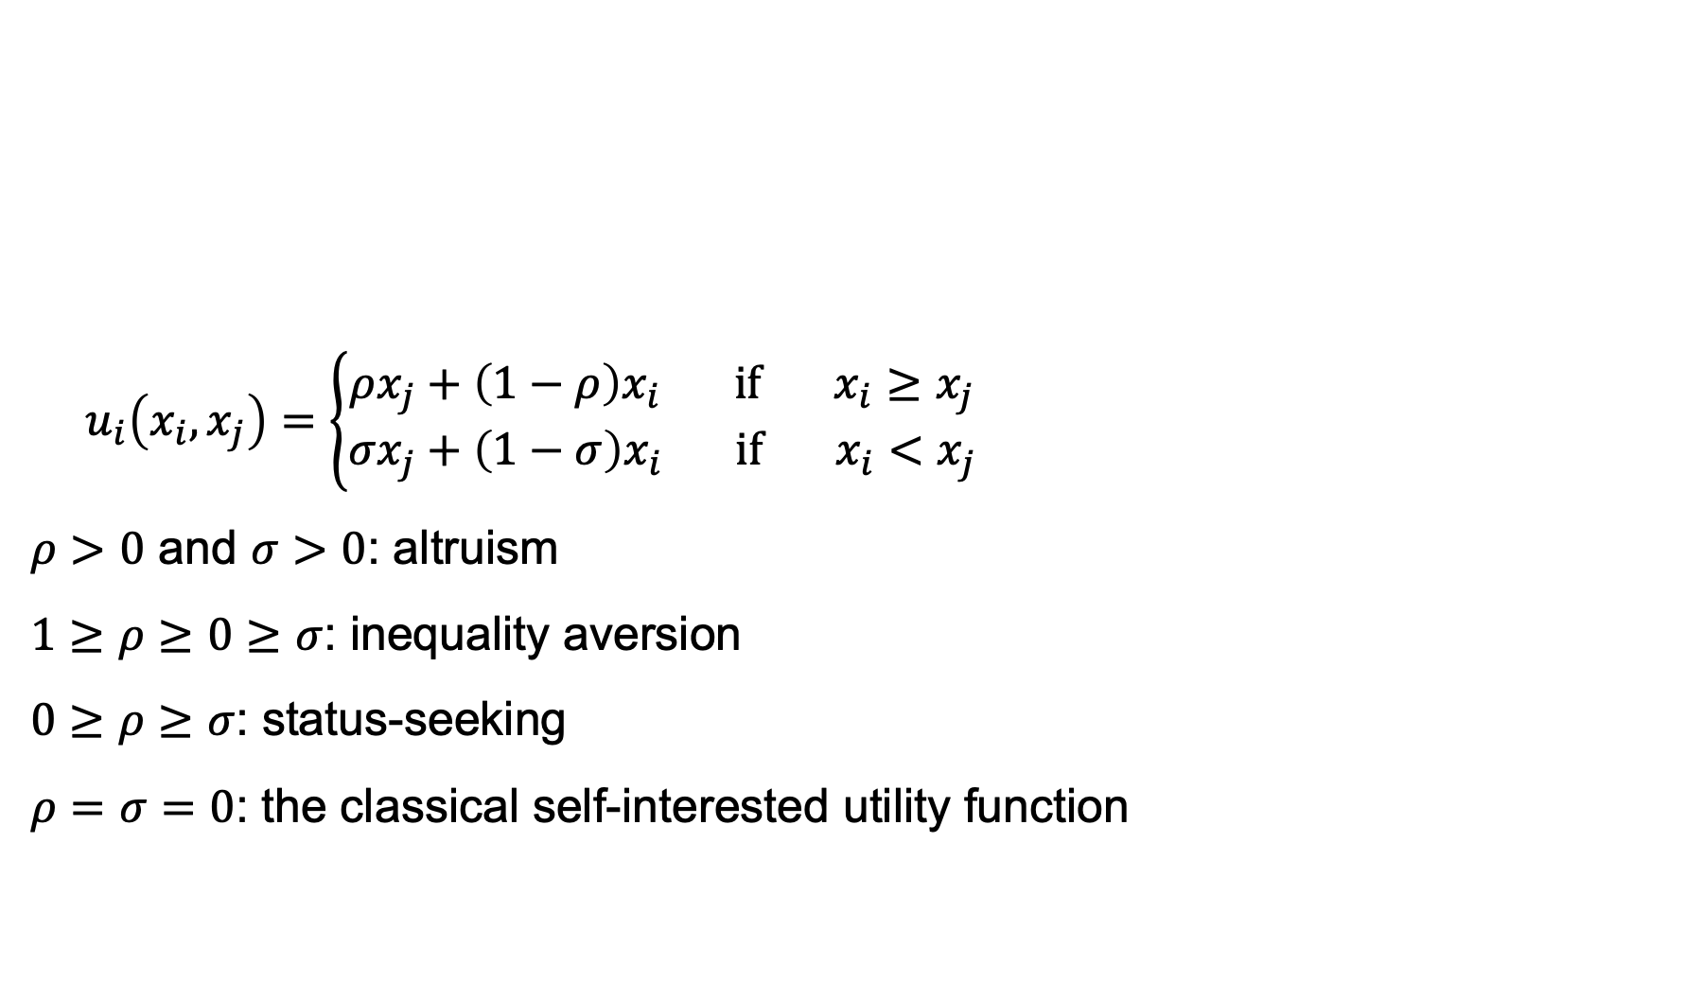
Other distributional preferences
$$u_{i}\left(x_{i},x_{j}\right)=\left\{\begin{aligned}ρx_{j}+\left(1−ρ\right)x_{i} if { x}_{i}≥x_{j} \\ σx_{j}+\left(1−σ\right)x_{i} if x_{i}<x_{j}\end{aligned}\right.$$
$ρ>0$ and $σ>0$: altruism
$1≥ρ≥0≥σ$: inequality aversion
$0≥ρ≥σ$: status-seeking
$ρ=σ=0$: the classical self-interested utility function

Slide 45
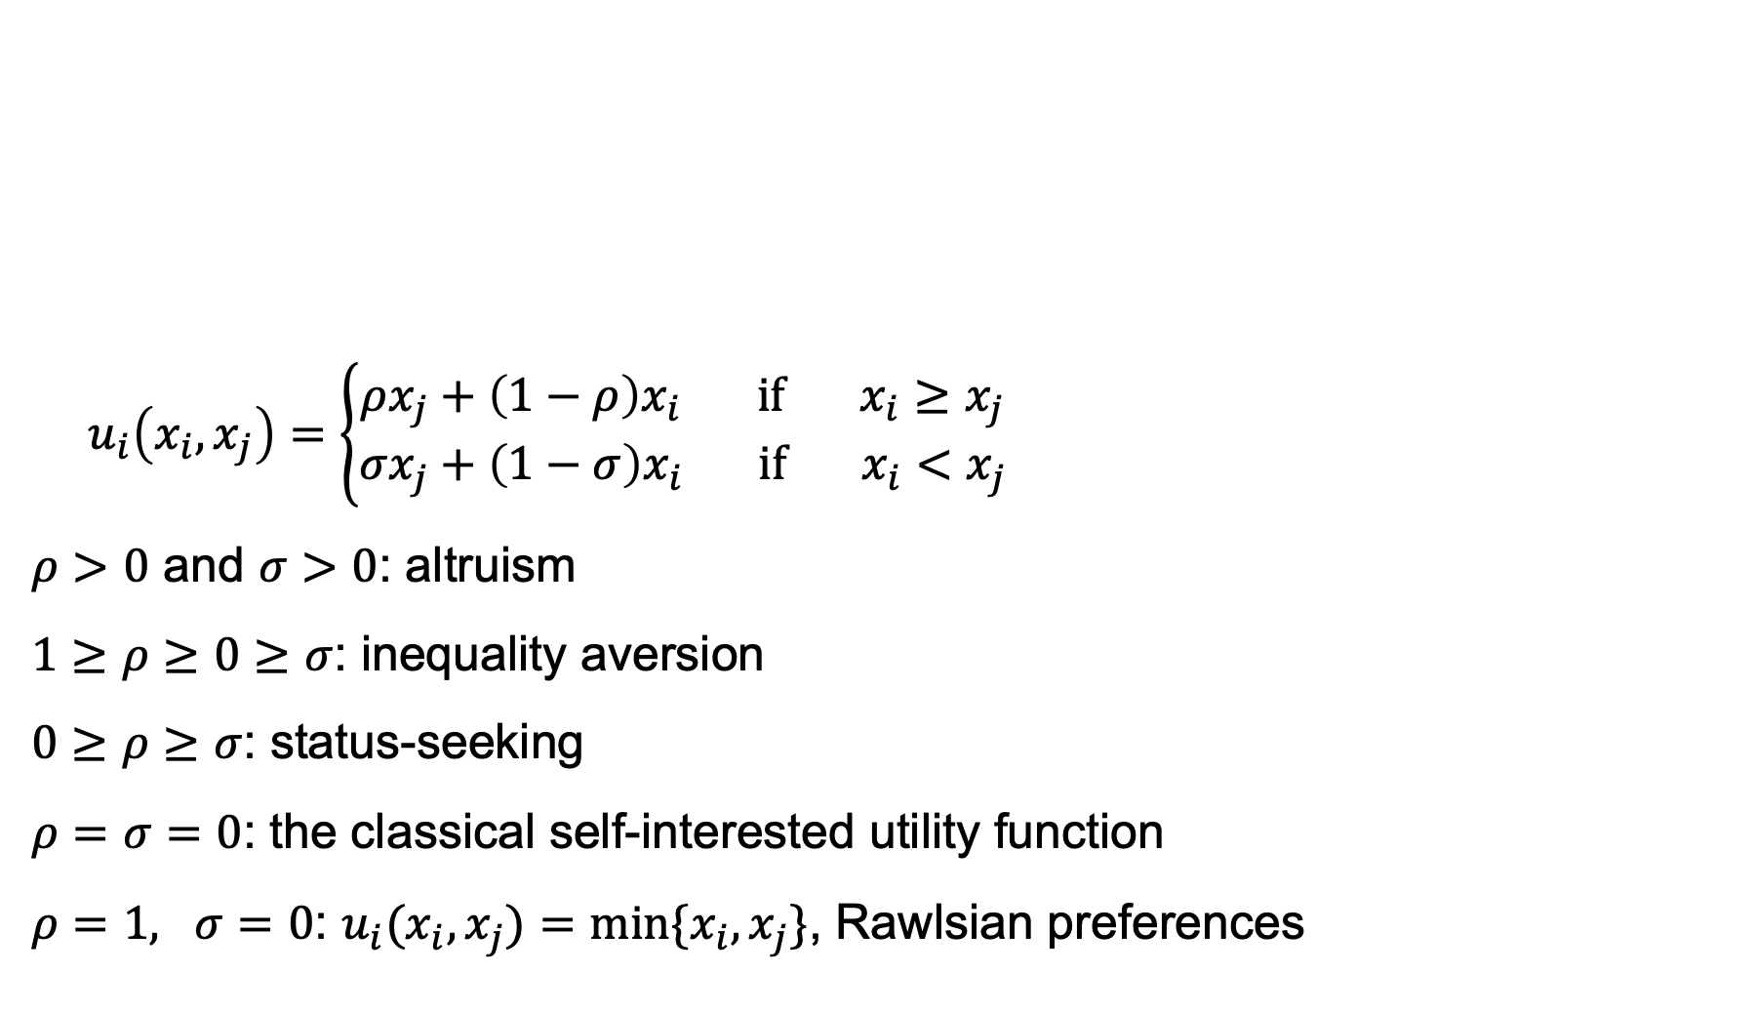
Other distributional preferences
$$u_{i}\left(x_{i},x_{j}\right)=\left\{\begin{aligned}ρx_{j}+\left(1−ρ\right)x_{i} if { x}_{i}≥x_{j} \\ σx_{j}+\left(1−σ\right)x_{i} if x_{i}<x_{j}\end{aligned}\right.$$
$ρ>0$ and $σ>0$: altruism
$1≥ρ≥0≥σ$: inequality aversion
$0≥ρ≥σ$: status-seeking
$ρ=σ=0$: the classical self-interested utility function
$ρ=1, σ=0$: $u_{i}(x_{i},x_{j})=min⁡\{x_{i},x_{j}\}$, Rawlsian preferences

Slide 46
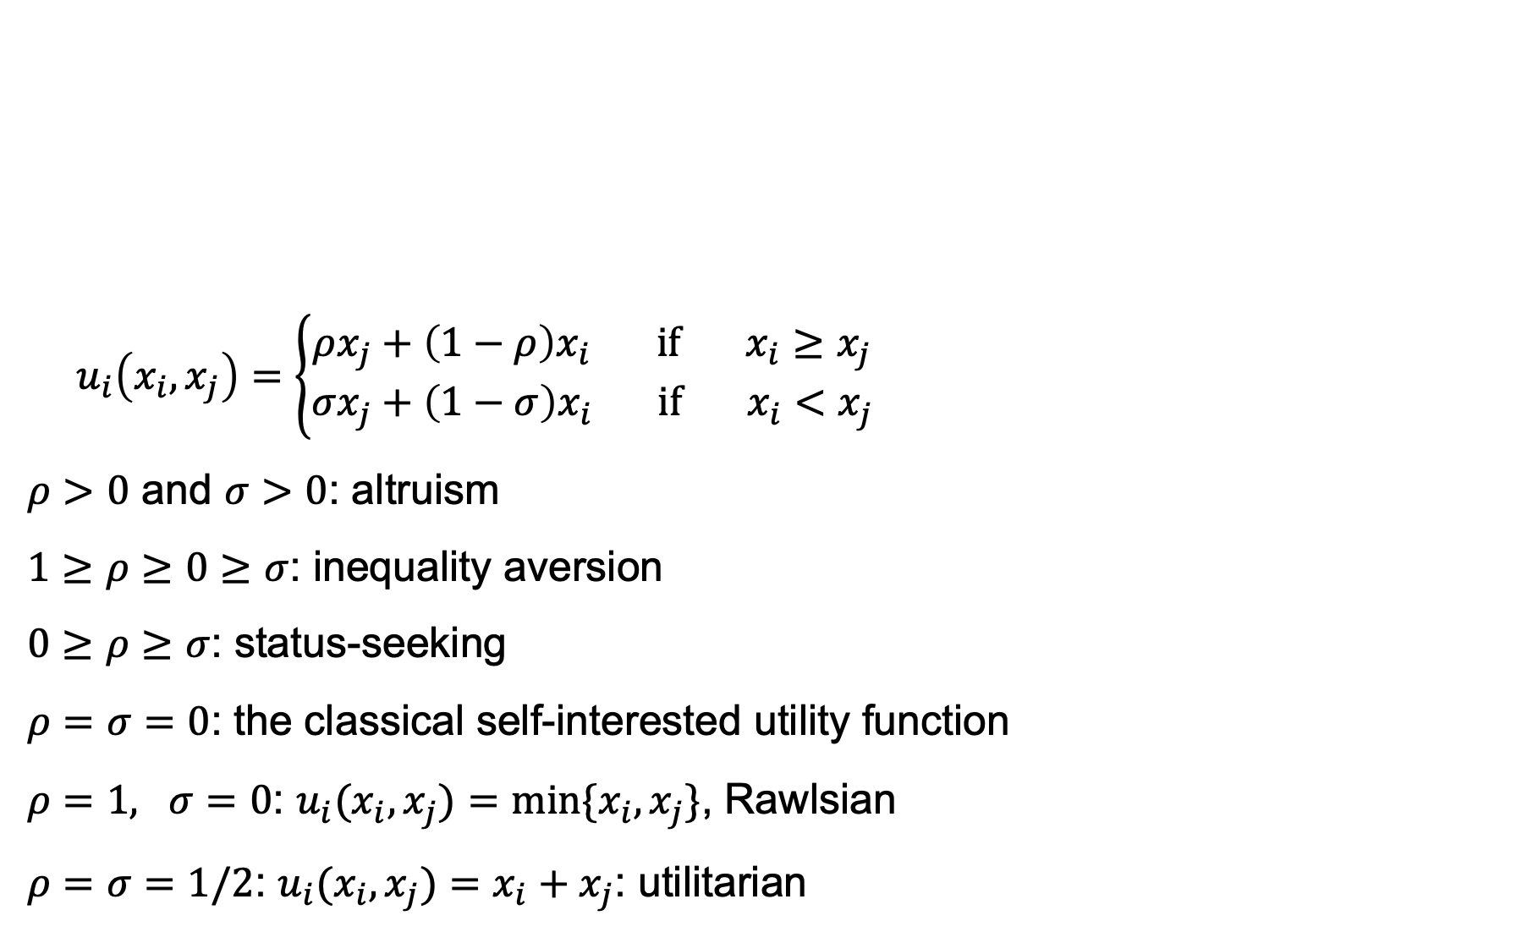
Other distributional preferences
$$u_{i}\left(x_{i},x_{j}\right)=\left\{\begin{aligned}ρx_{j}+\left(1−ρ\right)x_{i} if { x}_{i}≥x_{j} \\ σx_{j}+\left(1−σ\right)x_{i} if x_{i}<x_{j}\end{aligned}\right.$$
$ρ>0$ and $σ>0$: altruism
$1≥ρ≥0≥σ$: inequality aversion
$0≥ρ≥σ$: status-seeking
$ρ=σ=0$: the classical self-interested utility function
$ρ=1, σ=0$: $u_{i}(x_{i},x_{j})=min⁡\{x_{i},x_{j}\}$, Rawlsian
$ρ=σ=1/2$: $u_{i}(x_{i},x_{j})=x_{i}+x_{j}$: utilitarian

Slide 47
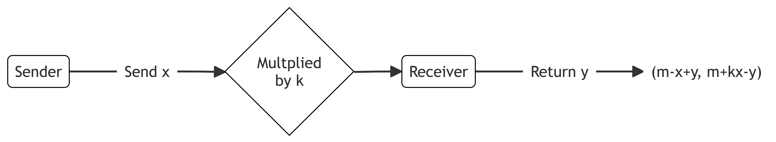
Example: the trust game

Slide 48
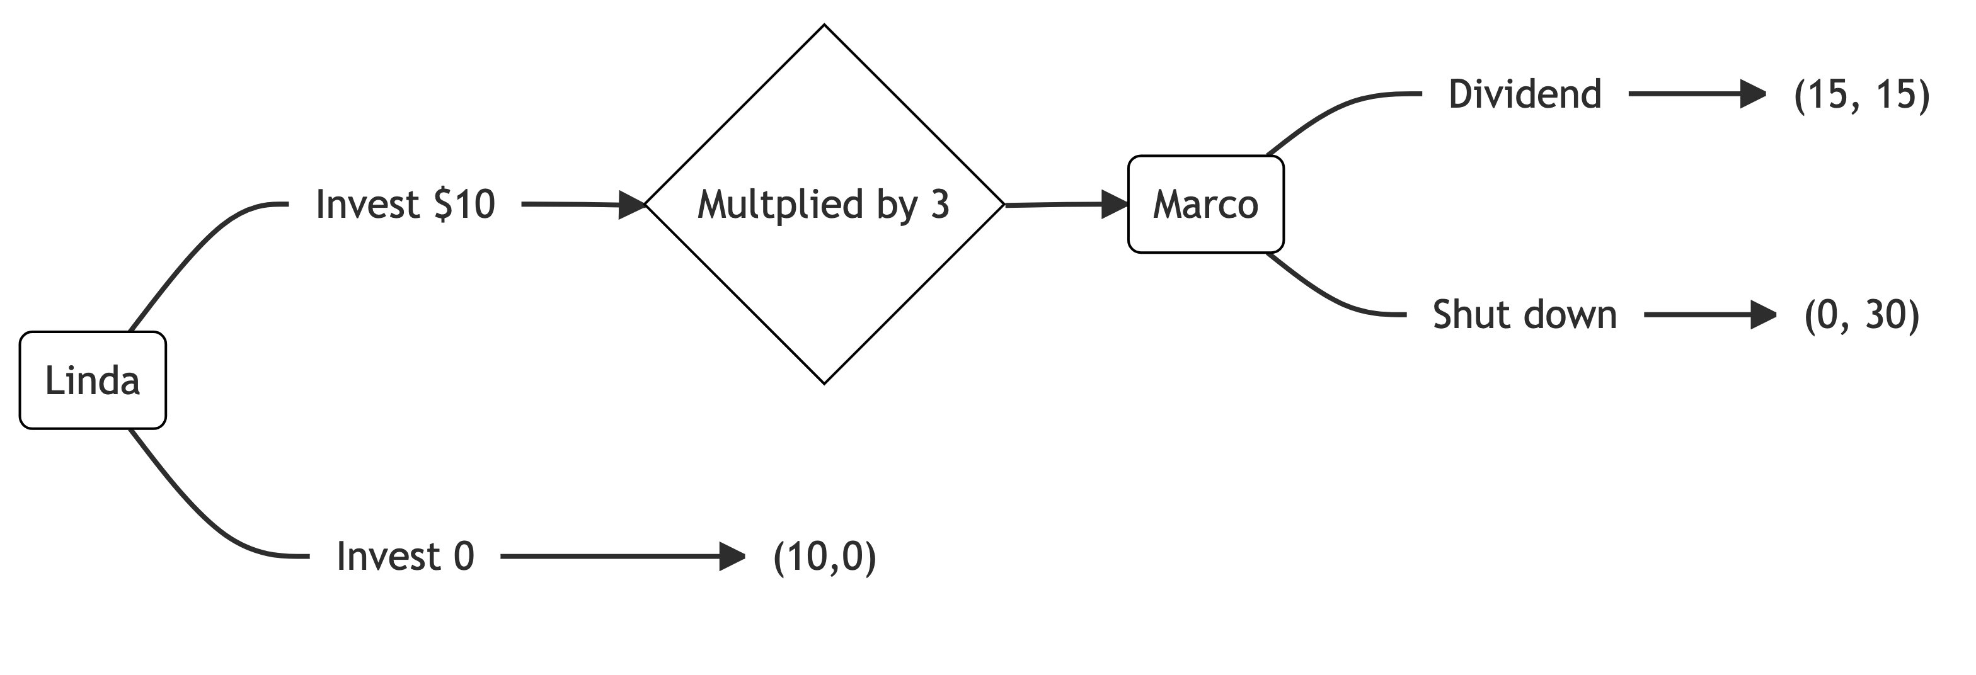
Example: the trust game

Slide 49
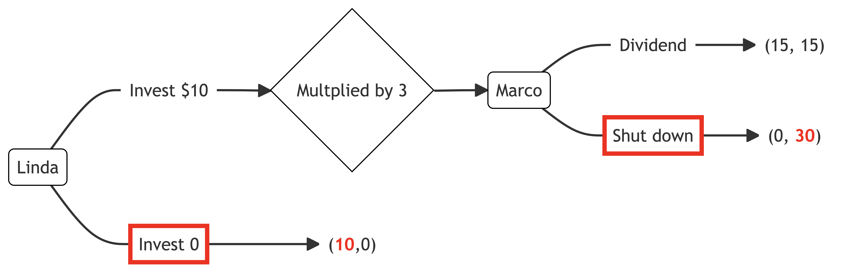
Example: the trust game

Slide 50
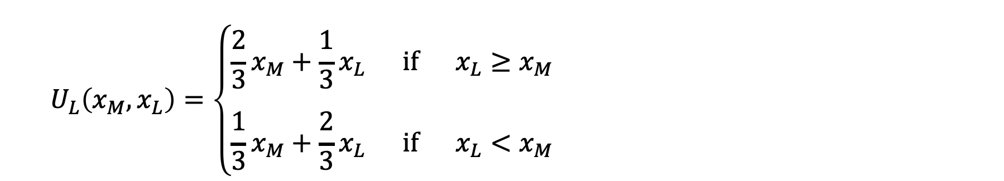
Example: the trust game
$$U_{L}\left(x_{M},x_{L}\right)=\left\{\begin{aligned}\frac{2}{3}x_{M}+\frac{1}{3}x_{L} if x_{L}≥x_{M} \\ \\ \frac{1}{3}x_{M}+\frac{2}{3}x_{L} if x_{L}<x_{M}\end{aligned}\right.$$

Slide 51
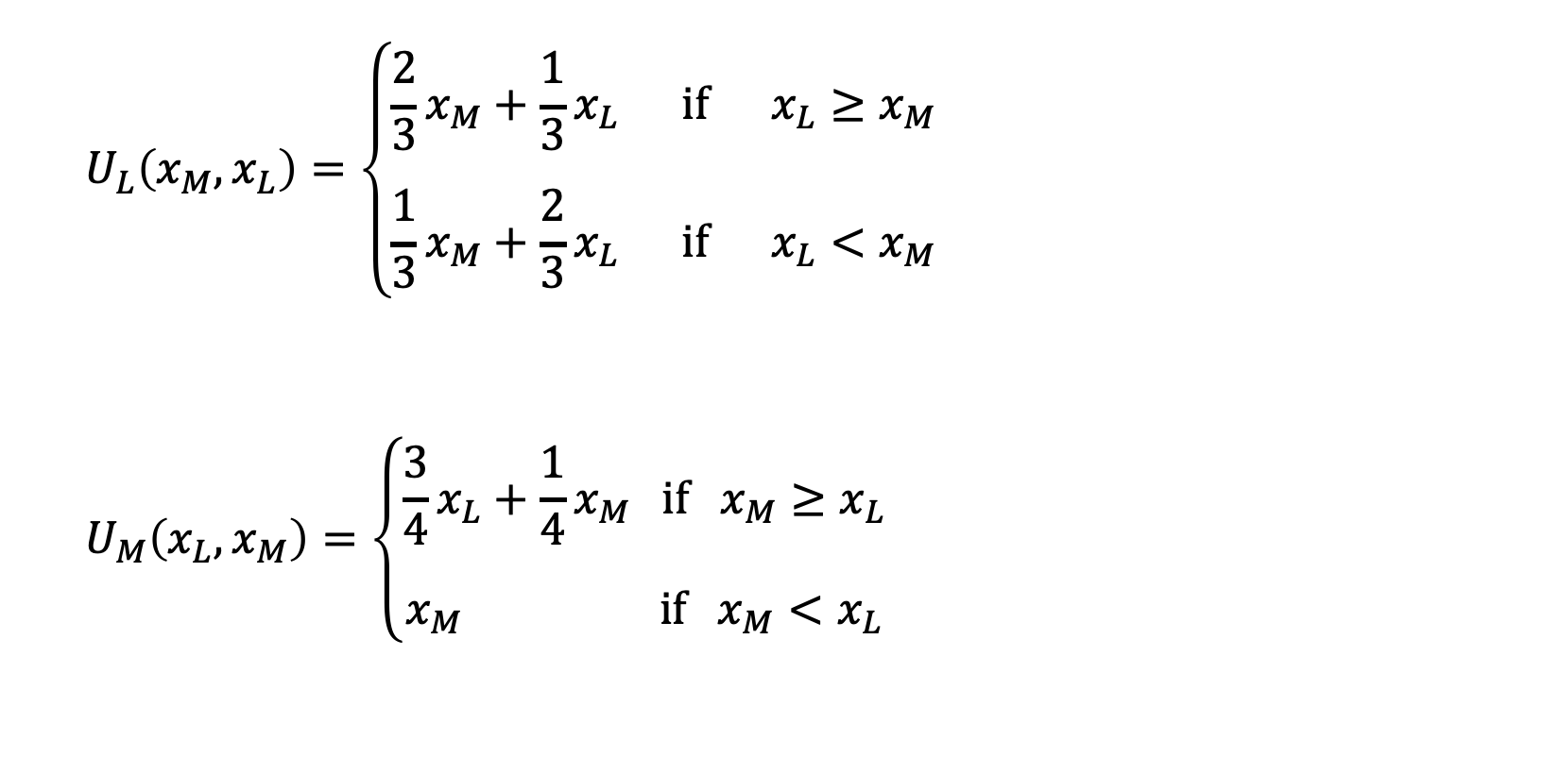
Example: the trust game
$$U_{L}\left(x_{M},x_{L}\right)=\left\{\begin{aligned}\frac{2}{3}x_{M}+\frac{1}{3}x_{L} if x_{L}≥x_{M} \\ \\ \frac{1}{3}x_{M}+\frac{2}{3}x_{L} if x_{L}<x_{M}\end{aligned}\right.$$
$$U_{M}\left(x_{L},x_{M}\right)=\left\{\begin{aligned}\frac{3}{4}x_{L}+\frac{1}{4}x_{M} if x_{M}≥x_{L} \\ \\ x_{M} if x_{M}<x_{L}\end{aligned}\right.$$

Slide 52
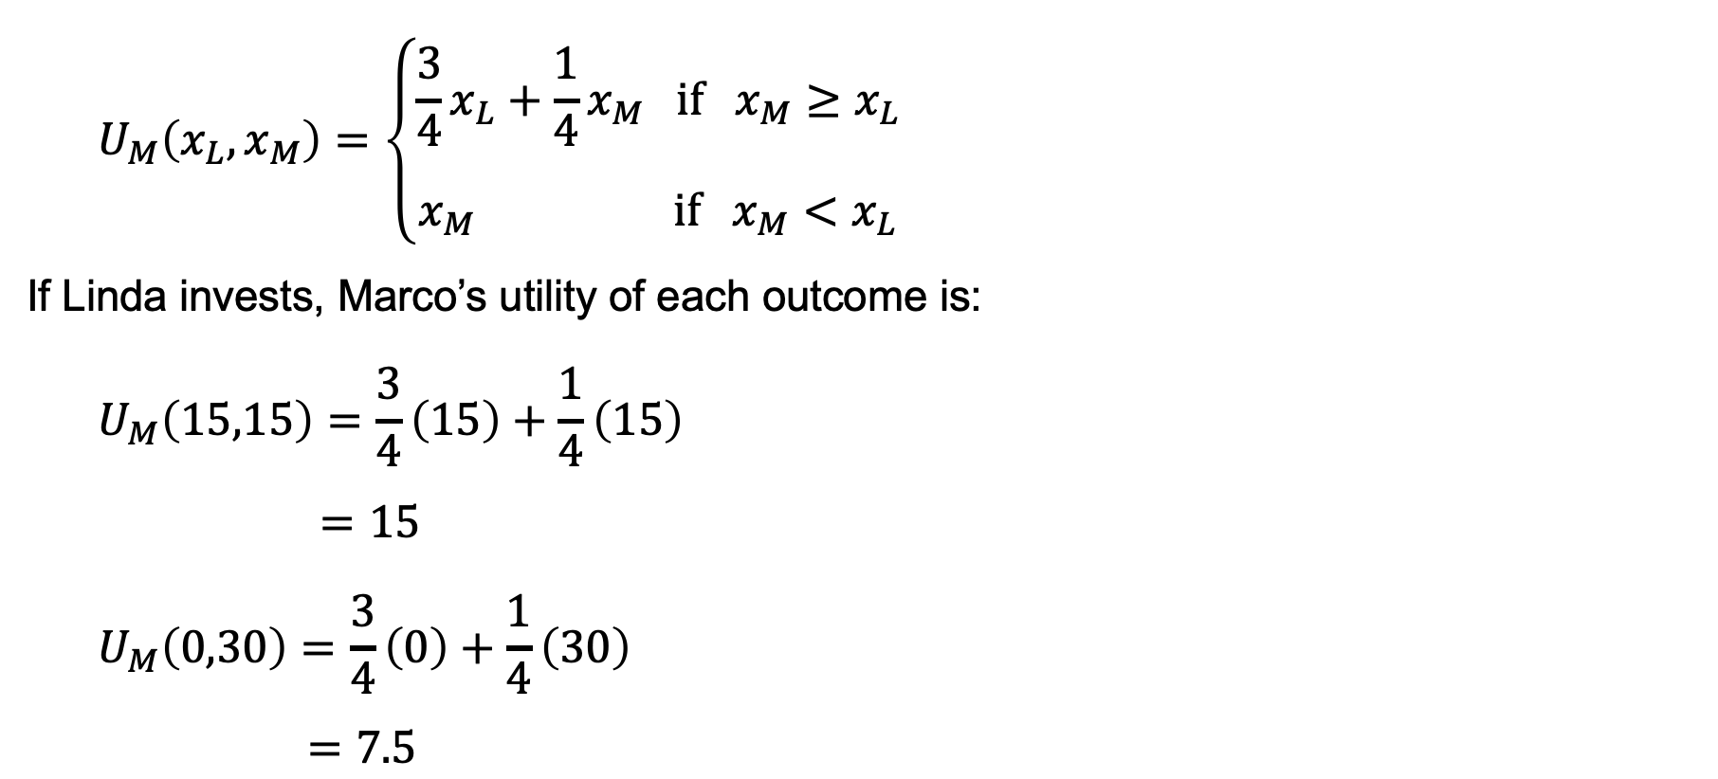
Example: the trust game
$$U_{M}\left(x_{L},x_{M}\right)=\left\{\begin{aligned}\frac{3}{4}x_{L}+\frac{1}{4}x_{M} if x_{M}≥x_{L} \\ \\ x_{M} if x_{M}<x_{L}\end{aligned}\right.$$
If Linda invests, Marco’s utility of each outcome is:
$$U_{M}\left(15,15\right)=\frac{3}{4}\left(15\right)+\frac{1}{4}\left(15\right)$$
$=15$
$$U_{M}\left(0,30\right)=\frac{3}{4}\left(0\right)+\frac{1}{4}\left(30\right)$$
$=7.5$

Slide 53
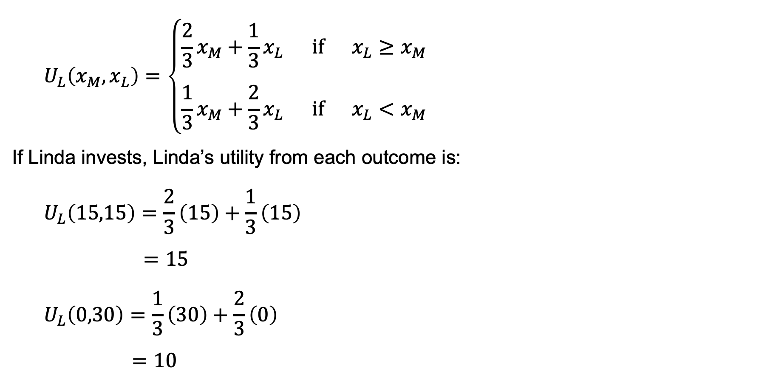
Example: the trust game
$$U_{L}\left(x_{M},x_{L}\right)=\left\{\begin{aligned}\frac{2}{3}x_{M}+\frac{1}{3}x_{L} if x_{L}≥x_{M} \\ \\ \frac{1}{3}x_{M}+\frac{2}{3}x_{L} if x_{L}<x_{M}\end{aligned}\right.$$
If Linda invests, Linda’s utility from each outcome is:
$$U_{L}\left(15,15\right)=\frac{2}{3}\left(15\right)+\frac{1}{3}\left(15\right)$$
$=15$
$$U_{L}\left(0,30\right)=\frac{1}{3}\left(30\right)+\frac{2}{3}\left(0\right)$$
$=10$

Slide 54
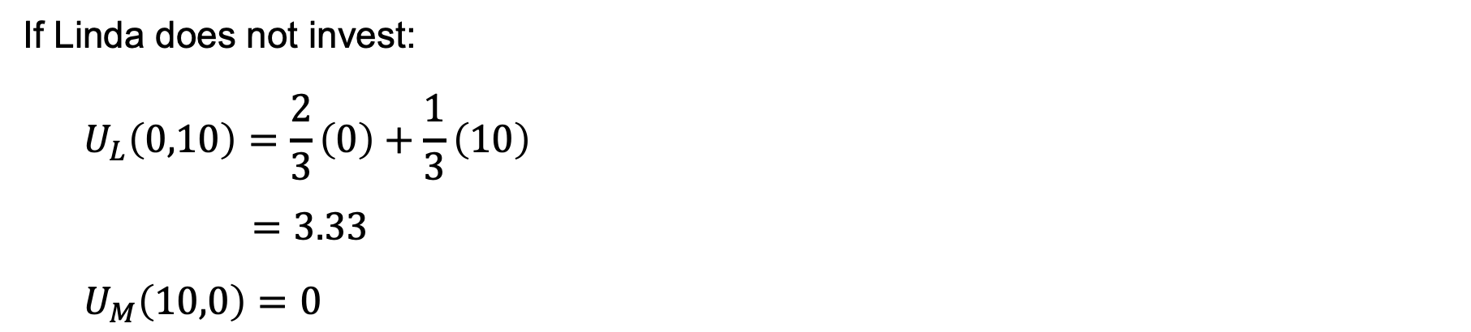
Example: the trust game
If Linda does not invest:
$$U_{L}\left(0,10\right)=\frac{2}{3}\left(0\right)+\frac{1}{3}\left(10\right)$$
$=3.33$
$$U_{M}\left(10,0\right)=0$$

Slide 55
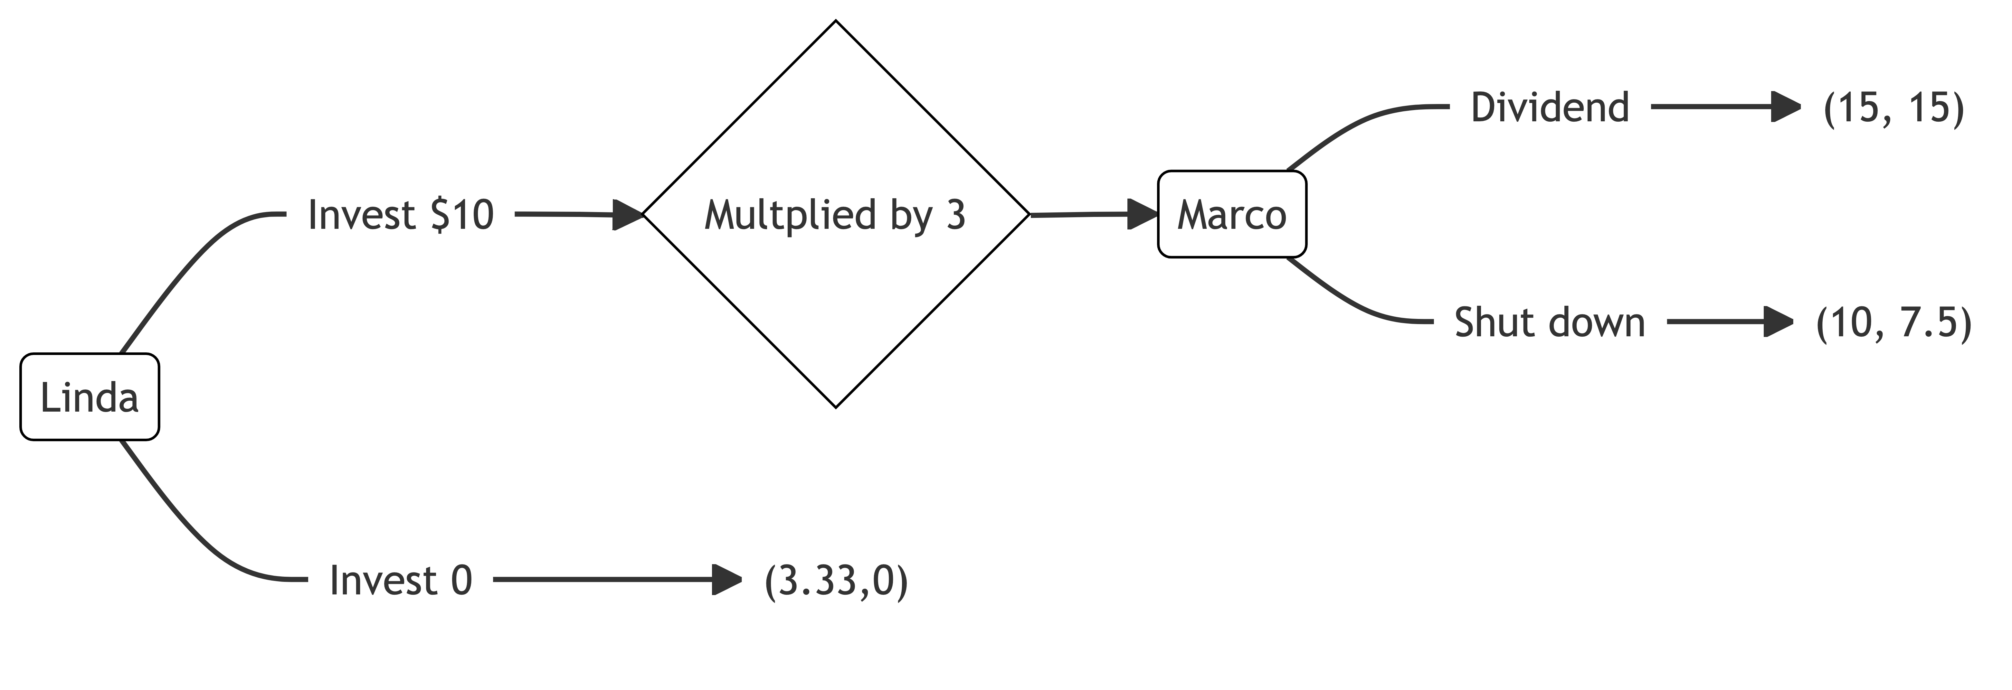
Example: the trust game

Slide 56
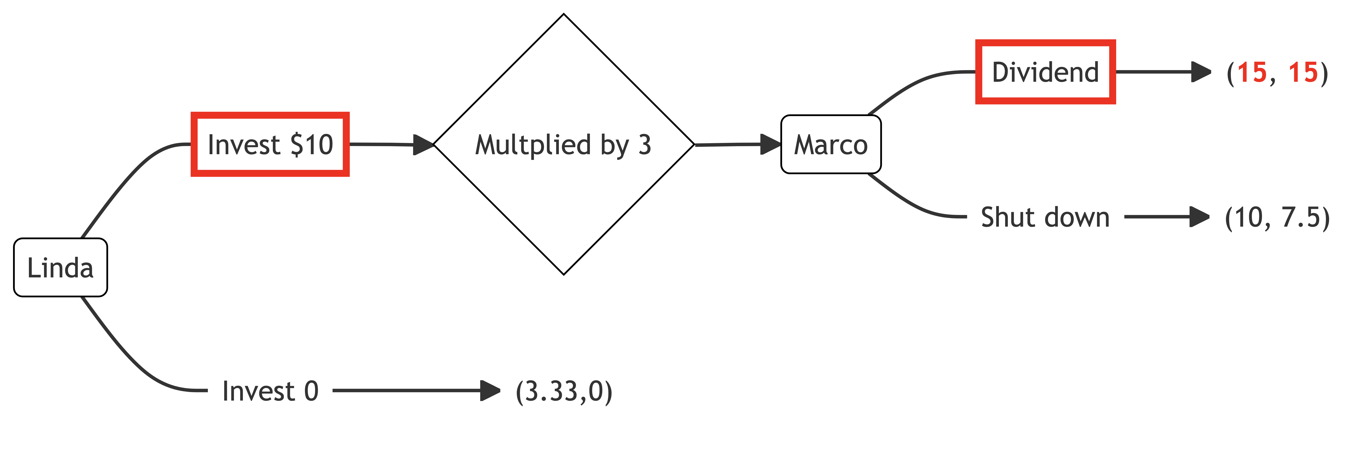
Example: the trust game

